Slide 2
The Special Senses
P A R T A

Slide 3
Eye and Associated Structures
70% of all sensory receptors are in the eye
Most of the eye is protected by a cushion of fat and the bony orbit
Accessory structures include eyebrows, eyelids, conjunctiva, lacrimal apparatus, and extrinsic eye muscles

Slide 4
Eyebrows
Functions include:
Shading the eye
Preventing perspiration from reaching the eye

Slide 5
Palpebrae (Eyelids)
Protect the eye anteriorly
Palpebral fissure – separates eyelids
Canthi – medial and lateral angles (commissures)

Slide 6
Palpebrae (Eyelids)
Lacrimal caruncle – contains glands that secrete a whitish, oily secretion (Sandman’s eye sand)
Tarsal plates of connective tissue support the eyelids internally
Eyelashes
Project from the free margin of each eyelid
Initiate reflex blinking

Slide 7
Palpebrae (Eyelids)
Lubricating glands associated with the eyelids
Meibomian glands (modified sebaceous glands)
Ciliary glands lie between the hair follicles (sweat and sebaceous glands)

Slide 8
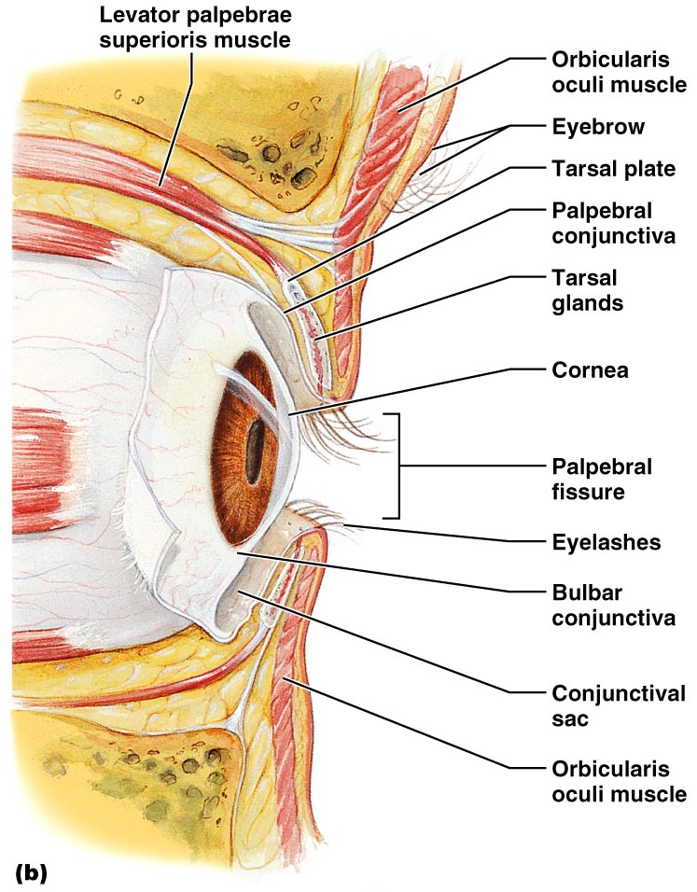
Palpebrae (Eyelids)
Figure 15.1b

Slide 9
Conjunctiva
Transparent mucous membrane that:
Lines the eyelids as the palpebral conjunctiva
Covers the whites of the eyes as the ocular or bulbar conjunctiva
Lubricates and protects the eye

Slide 10
Lacrimal Apparatus
Consists of the lacrimal gland and associated ducts
Lacrimal glands secrete tears
Located on the lateral portion of the eye

Slide 11
Lacrimal Apparatus
Tears
Contain mucus, antibodies, and lysozyme
Enter the eye via superolateral excretory ducts
Exit the eye medially via the lacrimal punctum
Drain into lacrimal canaliculus, lacrimal sac and then into the nasolacrimal duct

Slide 12
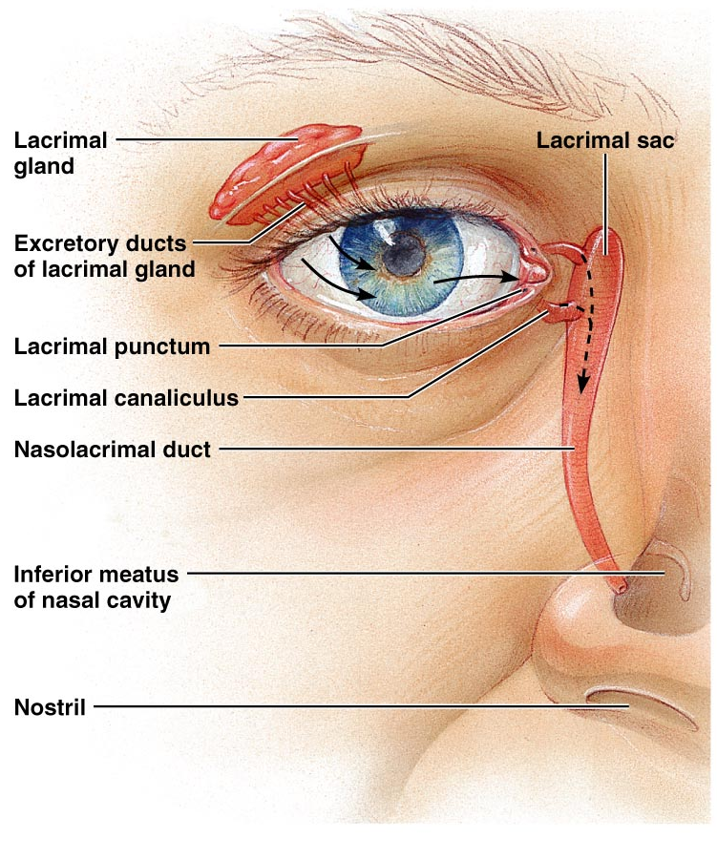
Lacrimal Apparatus
Figure 15.2

Slide 13
Extrinsic Eye Muscles
Six extrinsic eye muscles
Enable the eye to follow moving objects
Maintain the shape of the eyeball

Slide 14
Structure of the Eyeball
A slightly irregular hollow sphere with anterior and posterior poles
The wall is composed of three tunics – fibrous, vascular, and sensory
The internal cavity is filled with fluids called humors
The lens separates the internal cavity into anterior and posterior segments

Slide 15
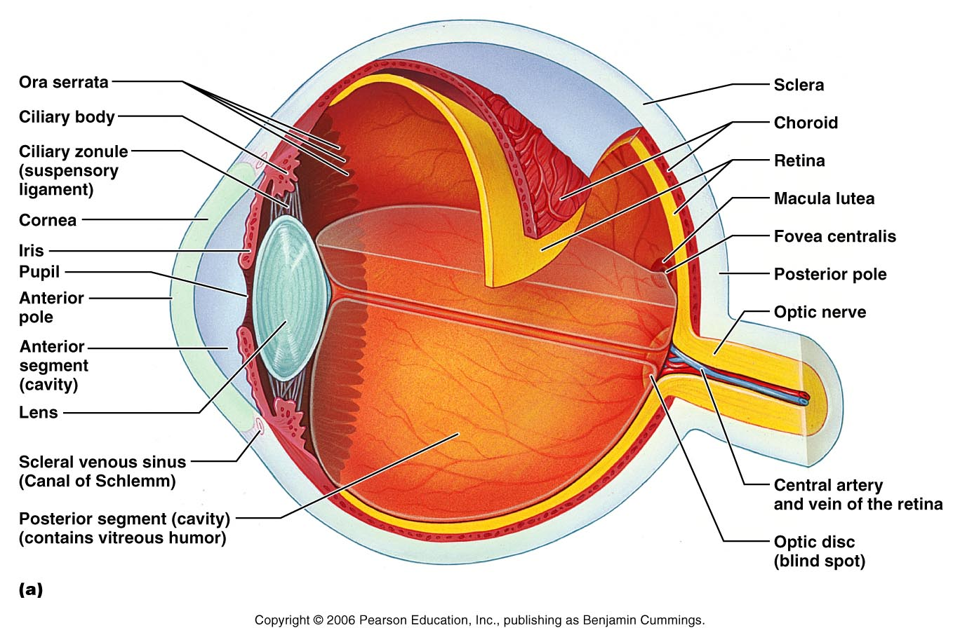
Structure of the Eyeball
Figure 15.4a

Slide 16
Fibrous Tunic
Forms the outermost coat of the eye and is composed of:
Opaque sclera (posteriorly)
Clear cornea (anteriorly)
The sclera protects the eye and anchors extrinsic muscles
The cornea lets light enter the eye

Slide 17
Vascular Tunic or Uvea
Has three regions: choroid, ciliary body, and iris
Choroid region
A dark brown membrane that forms the posterior portion of the uvea
Supplies blood to all eye tunics

Slide 18
Vascular Tunic or Uvea
Ciliary body
A thickened ring of tissue surrounding the lens
Composed of the ciliary muscles (smooth muscle)
anchor the suspensory ligament that holds the lens in place
Ciliary processes
Secrets the aqueous humor

Slide 19
Vascular Tunic: Iris
Pupil – central opening of the iris
Regulates the amount of light entering the eye during:
Close vision and bright light – pupils constrict
Distant vision and dim light – pupils dilate
Changes in emotional state – pupils dilate when the subject matter is appealing or requires problem-solving skills

Slide 20
Pupil Dilation and Constriction
Figure 15.5

Slide 21
Sensory Tunic: Retina
A delicate two-layered membrane
Pigmented layer – the outer layer that absorbs light and prevents its scattering
Neural layer, which contains:
Photoreceptors that transduce light energy
Bipolar cells and ganglion cells
Horizontal and amacrine cells

Slide 22
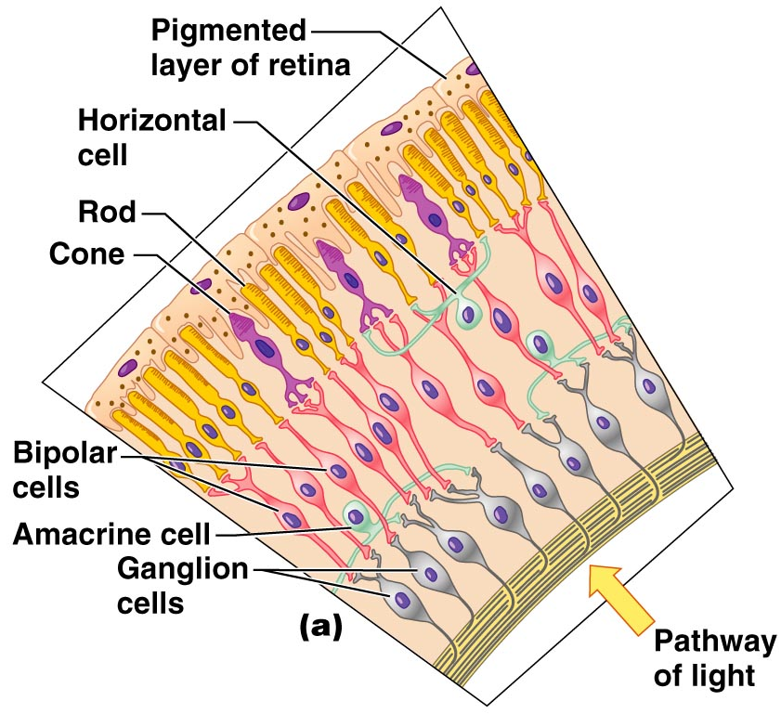
Sensory Tunic: Retina
Figure 15.6a

Slide 23
The Retina: Ganglion Cells and the Optic Disc
Ganglion cell axons:
Run along the inner surface of the retina
Leave the eye as the optic nerve
The optic disc:
Is the site where the optic nerve leaves the eye
Lacks photoreceptors (the blind spot)

Slide 24
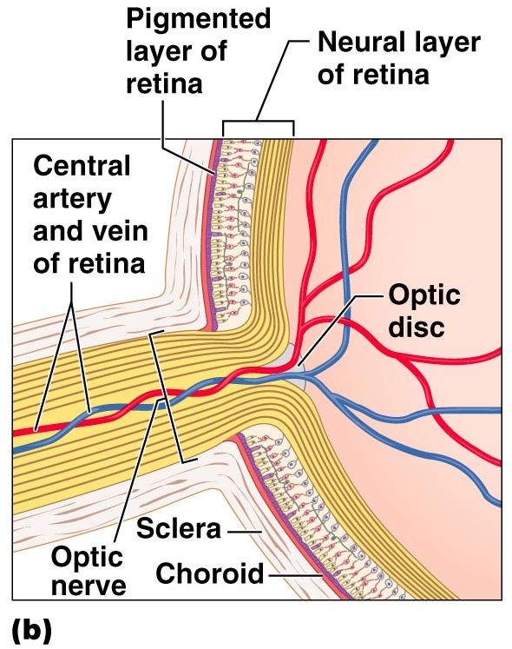
The Retina: Ganglion Cells and the Optic Disc
Figure 15.6b

Slide 25
The Retina: Photoreceptors
Rods:
Respond to dim light
Are used for peripheral vision
Cones:
Respond to bright light
Have high-acuity color vision
Macula lutea – mostly cones
Fovea centralis – only cones

Slide 26
Blood Supply to the Retina
The neural retina receives its blood supply from two sources
The outer third receives its blood from the choroid
The inner two-thirds is served by the central artery and vein
Small vessels radiate out from the optic disc and can be seen with an ophthalmoscope

Slide 27
The Special Senses
P A R T B

Slide 28
Inner Chambers and Fluids
The lens separates the internal eye into
Anterior segment
Anterior chamber
Posterior chamber
Posterior segment

Slide 29
Inner Chambers and Fluids
The posterior segment is filled with a clear gel called vitreous humor that:
Transmits light
Supports the posterior surface of the lens
Holds the neural retina firmly against the pigmented layer
Contributes to intraocular pressure

Slide 30
Anterior Segment
Anterior Chamber– between the cornea and the iris
Posterior Chamber – between the iris and the lens
Aqueous humor
A plasmalike fluid that fills the anterior segment
Drains via the canal of Schlemm
Supports, nourishes, and removes wastes

Slide 31
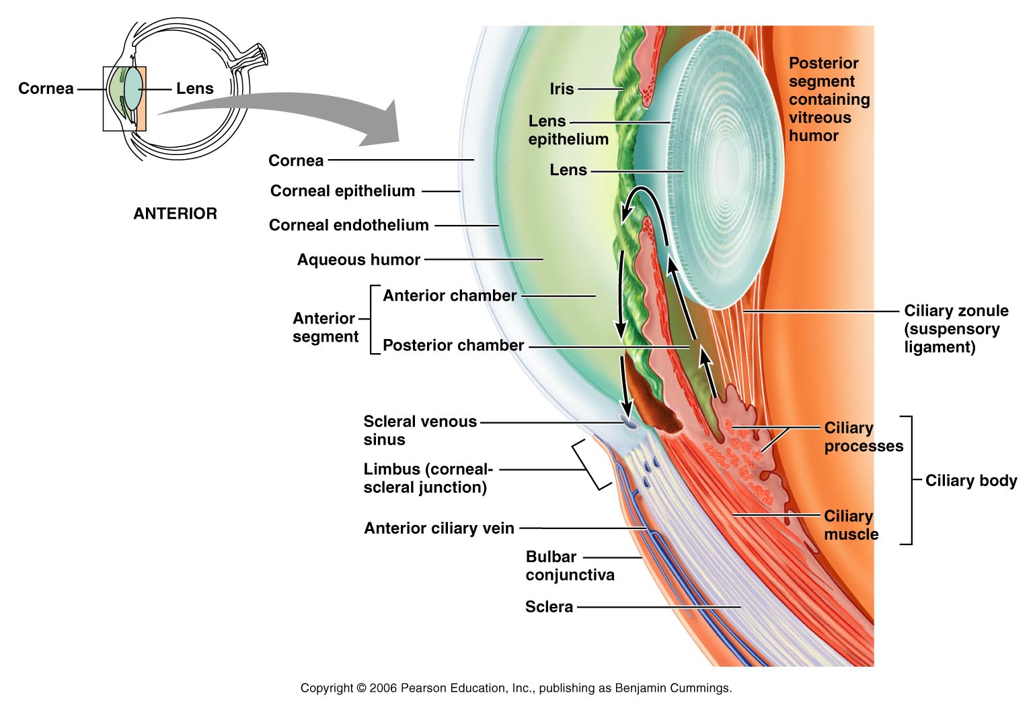
Anterior Segment
Figure 15.8

Slide 32
Lens
A biconvex, transparent, flexible, avascular structure that:
Allows precise focusing of light onto the retina
Is composed of epithelium and lens fibers

Slide 33
Lens
Lens epithelium – anterior cells that differentiate into lens fibers
Lens fibers – cells filled with the transparent protein crystallin
With age, the lens becomes more compact and dense and loses its elasticity

Slide 34
Light
Electromagnetic radiation – all energy waves from short gamma rays to long radio waves
Our eyes respond to a small portion of this spectrum called the visible spectrum
Different cones in the retina respond to different wavelengths of the visible spectrum

Slide 35
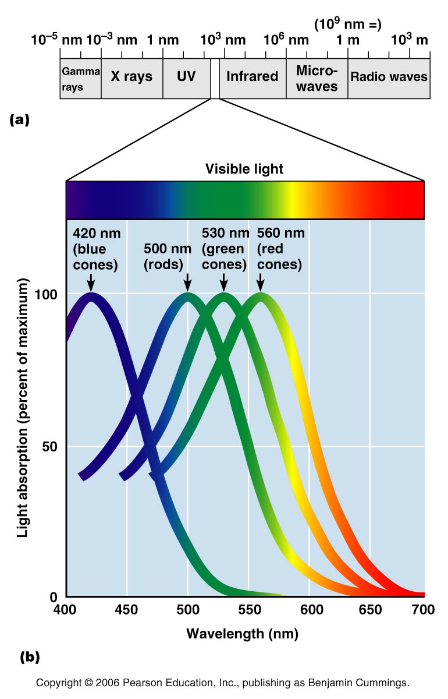
Light
Figure 15.10

Slide 36
Refraction and Lenses
When light passes from one transparent medium to another
Light passing through a convex lens (as in the eye) is bent so that the rays converge to a focal point
When a convex lens forms an image, the image is upside down and reversed right to left

Slide 37
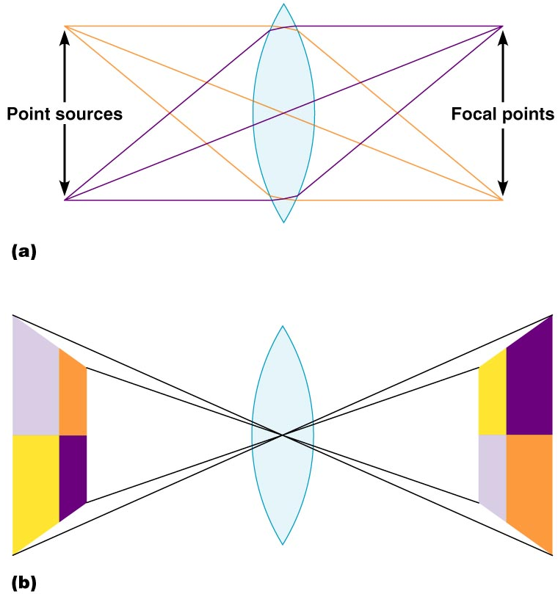
Refraction and Lenses
Figure 15.12a, b

Slide 38
Focusing Light on the Retina
Pathway of light entering the eye: cornea, aqueous humor, lens, vitreous humor, and the neural layer of the retina to the photoreceptors
Light is refracted:
At the cornea
Entering the lens
Leaving the lens
The lens curvature and shape allow for fine focusing of an image

Slide 39
Focusing for Distant Vision
Light from a distance needs little adjustment for proper focusing
Far point of vision – the distance beyond which the lens does not need to change shape to focus (20 ft.)
Figure 15.13a

Slide 40
Focusing for Distant Vision

Slide 41
Focusing for Close Vision
Close vision requires:
Accommodation – changing the lens shape by ciliary muscles to increase refractory power
Constriction – the pupillary reflex constricts the pupils to prevent divergent light rays from entering the eye
Convergence – medial rotation of the eyeballs toward the object being viewed

Slide 42
Focusing for Close Vision
Figure 15.13b

Slide 43
Problems of Refraction
Emmetropic eye – normal eye
Myopic eye (nearsighted) – the focal point is in front of the retina
Corrected with a concave lens
Hyperopic eye (farsighted) – the focal point is behind the retina
Corrected with a convex lens

Slide 44
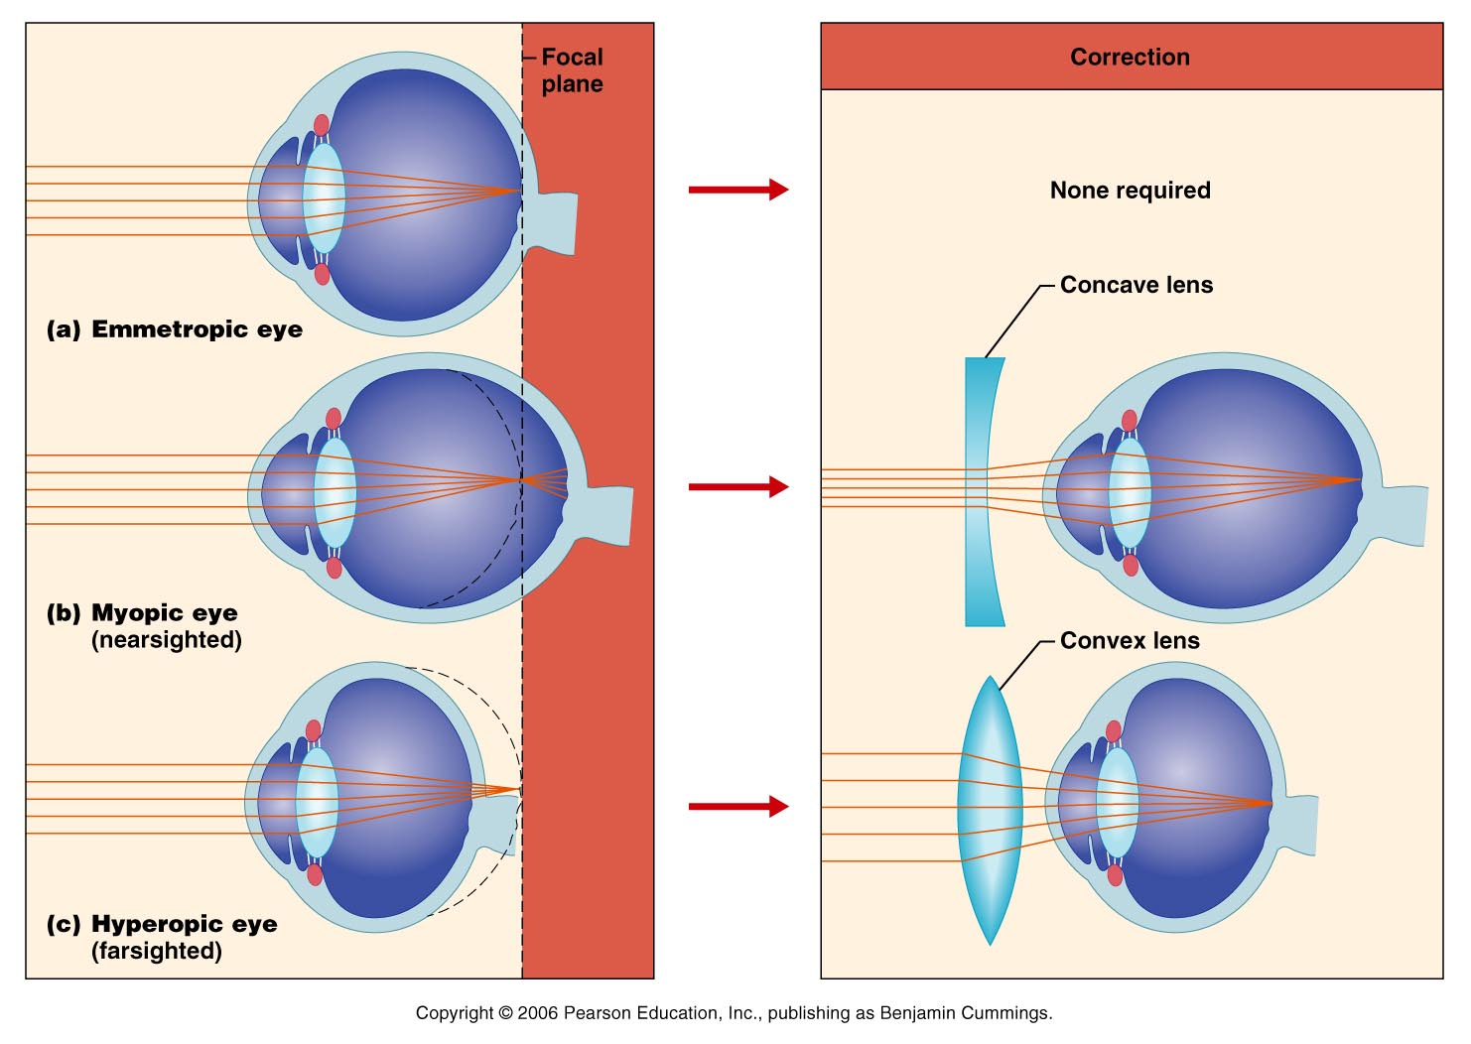
Problems of Refraction
Figure 15.14a, b

Slide 45
Photoreception
Photoreception – process by which the eye detects light energy
Rods and cones contain visual pigments (photopigments)
Arranged in a stack of disklike infoldings of the plasma membrane
Special epithelial cells - release neurotransmitters that stimulates neurons

Slide 46
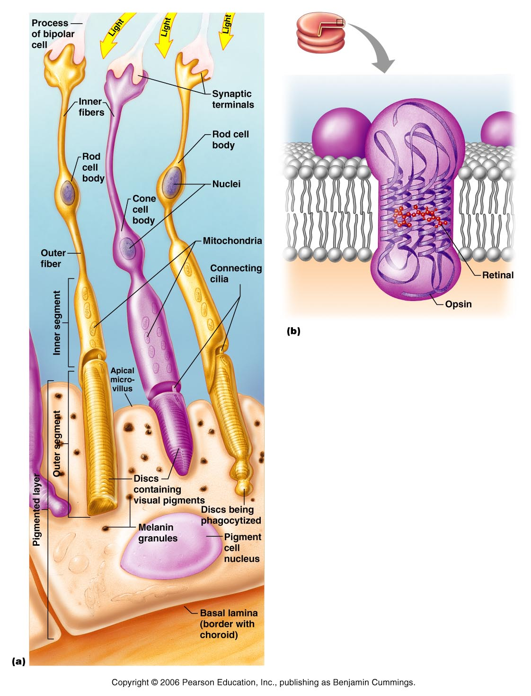
Figure 15.15a, b

Slide 47
Rods
Sensitive to dim light and best suited for night vision
Absorb all wavelengths of visible light
Perceived input is in gray tones only
Sum of visual input from many rods feeds into a single ganglion cell
Results in fuzzy and indistinct images
Notes:
Rods are derived from the same stem cells that produce ependymal cells of the brain.
Saladin page 621

Slide 48
Cones
Need bright light for activation (have low sensitivity)
Have pigments that furnish a vividly colored view
Each cone synapses with a single ganglion cell
Vision is detailed and has high resolution

Slide 49
Chemistry of Visual Pigments
Rhodopsin
Retinal is a light-absorbing molecule
Synthesized from vitamin A
Two isomers: 11-cis and 11-trans
Opsins – proteins
4 types that will absorb different wavelengths of light

Slide 50
Excitation of Rods
The visual pigment of rods is rhodopsin (opsin + 11-cis retinal)
Light phase
Rhodopsin breaks down into all-trans retinal + opsin (bleaching of the pigment)

Slide 51
Excitation of Rods
Dark phase
All-trans retinal converts to 11-cis form
11-cis retinal is also formed from vitamin A
11-cis retinal + opsin regenerate rhodopsin

Slide 52
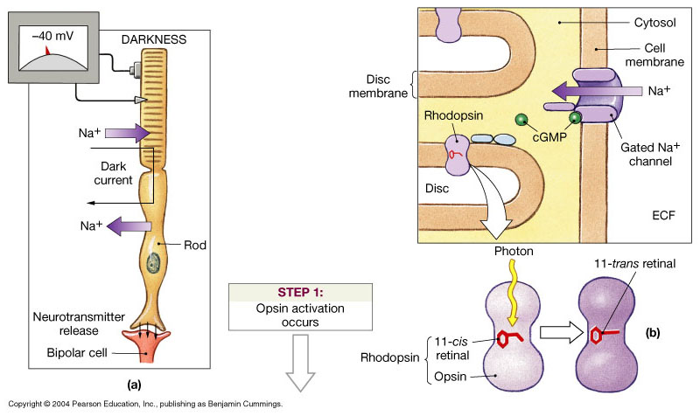
Photoreception

Slide 53
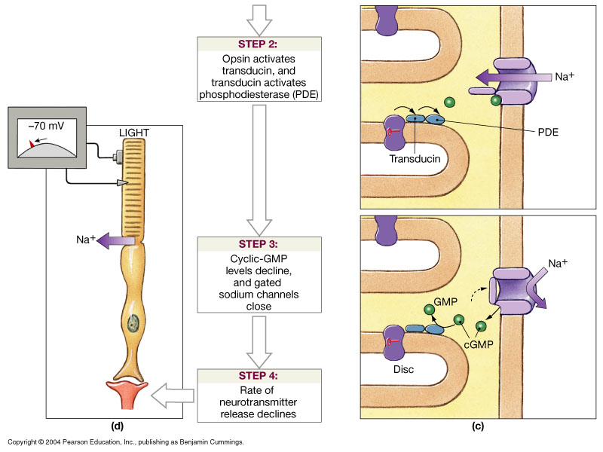
Photoreception

Slide 54
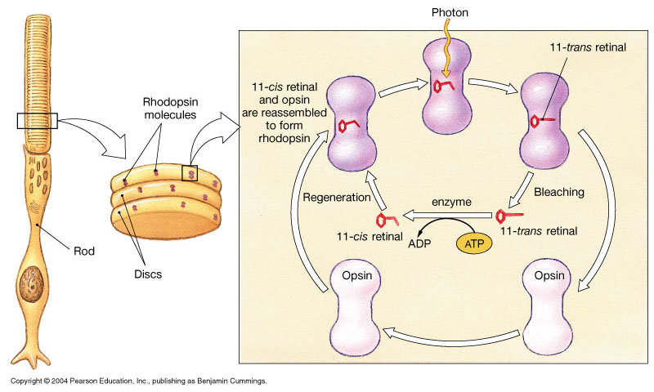
Bleaching and Regeneration of Visual Pigments

Slide 55
Phototransduction
Light energy splits rhodopsin into all-trans retinal, releasing activated opsin
The freed opsin activates the G protein transducin
Transducin catalyzes activation of phosphodiesterase (PDE)
PDE hydrolyzes cGMP to GMP and releases it from sodium channels
Without bound cGMP, sodium channels close, the membrane hyperpolarizes, and neurotransmitter cannot be released

Slide 56
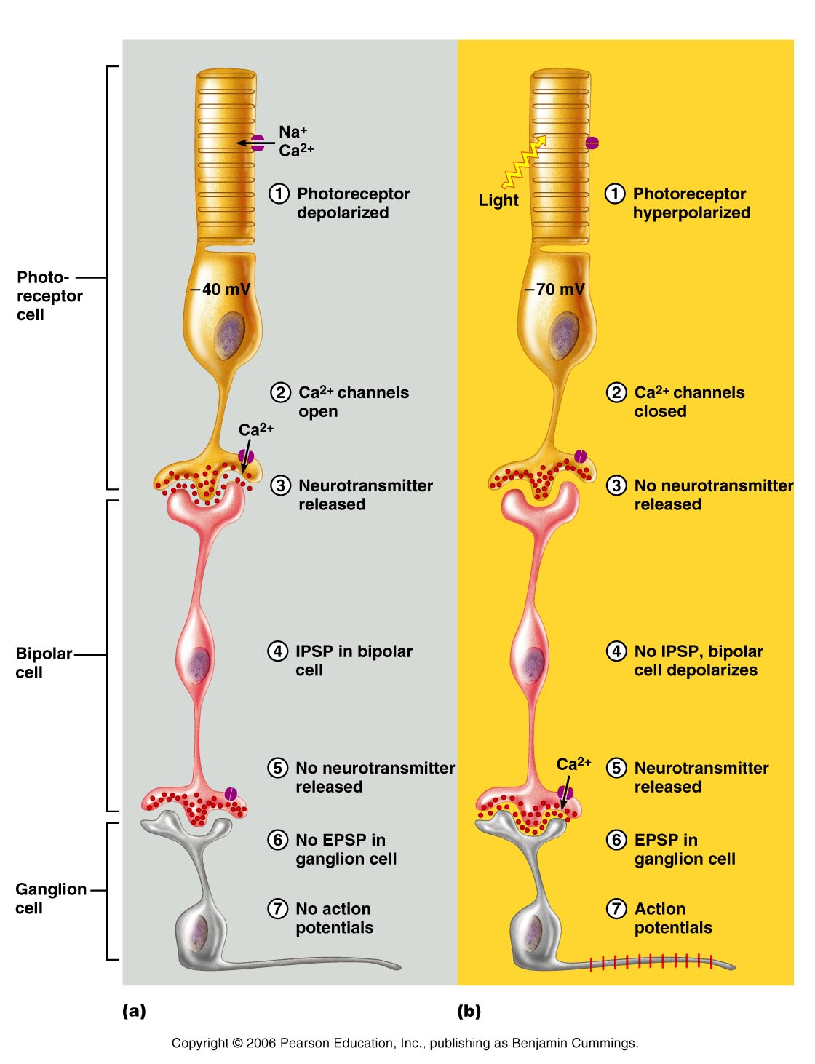
Signal Transmission in the Retina
Figure 15.17a
Notes:
There are 2 types of bipolar cells:
One is hyperpolarized by glutamate and depolarized when its secretion drops. This cell is excited by rising light intensity.
Another is excited by glutamate and inhibited when its secretion drops. This cell is excited by falling light intensity.
Saladin page 624

Slide 57
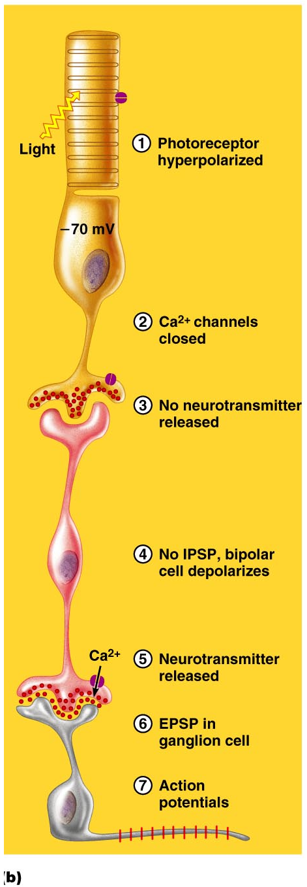
Signal Transmission
Figure 15.17b
Notes:
Ganglionic cells are the only retinal cells that produce an action potential. All others produce only local graded potentials.

Slide 58
Excitation of Cones
Visual pigments in cones are similar to rods (retinal + opsins)
There are three types of cones: blue, green, and red
Intermediate colors are perceived by activation of more than one type of cone
Method of excitation is similar to rods

Slide 59
Light Adaptation
Going from dark to light:
Fast bleaching of rods and cones
Glare
Rods are turned off
Retinal sensitivity is lost
Cones are turned on
Visual acuity is gained

Slide 60
Dark Adaptation
Going from light to dark:
Cones stop functioning and rods pigments have been bleached out by bright light
“We see blackness”
Rods are turned on
Rhodopsin accumulates in the dark and retinal sensitivity is restored

Slide 61
Visual Pathways
Axons of retinal ganglion cells form the optic nerve
Medial fibers of the optic nerve decussate at the optic chiasm
Most fibers of the optic tracts continue to the thalamus
Fibers from the thalamus form the optic radiation
Optic radiations travel to the visual cortex

Slide 62
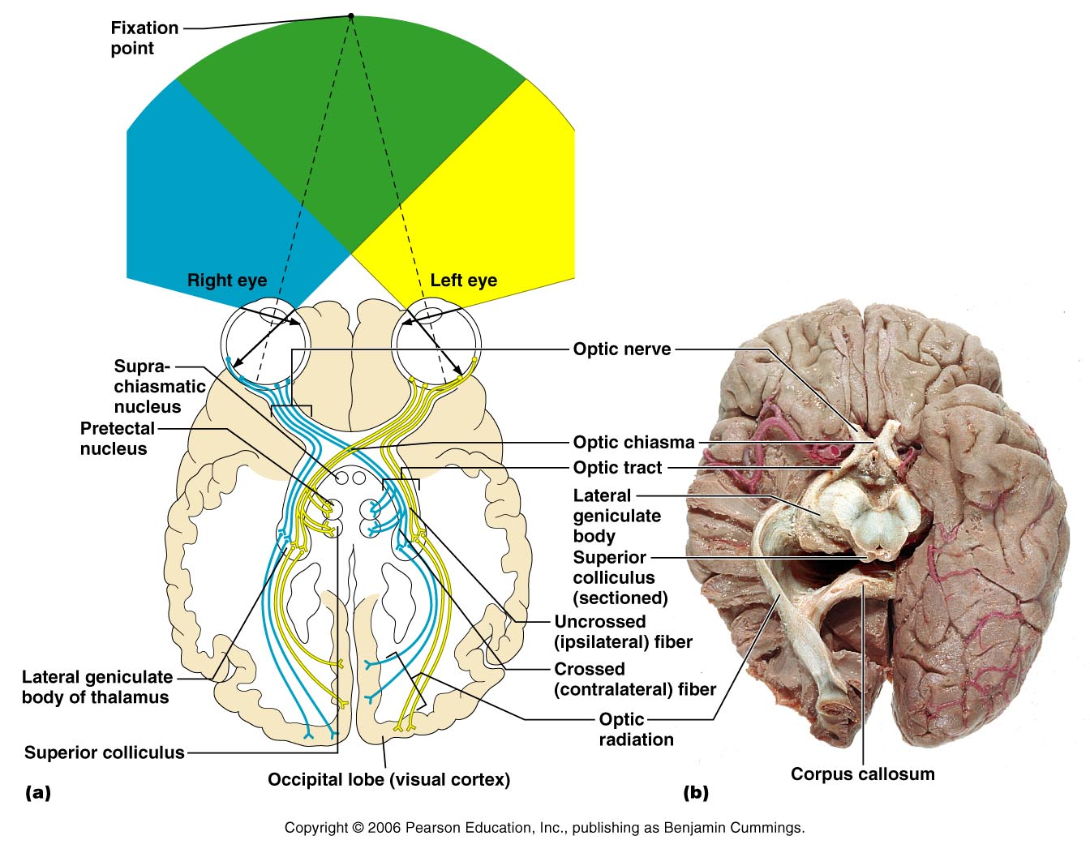
Visual Pathways
Figure 15.19

Slide 63
Visual Pathways
Some nerve fibers send tracts to the midbrain ending in the superior colliculi
A small subset of visual fibers contain melanopsin (circadian pigment) which:
Mediates pupillary light reflexes
Sets daily biorhythms

Slide 64
Depth Perception
Achieved by both eyes viewing the same image from slightly different angles
Three-dimensional vision results from cortical fusion of the slightly different images
If only one eye is used, depth perception is lost and the observer must rely on learned clues to determine depth

Slide 65
Thalamic Processing
The thalamus:
Relay information on movement
Segregate the retinal axons in preparation for depth perception
Emphasize visual inputs from regions of high cone density
Sharpen the contrast information received by the retina

Slide 66
Cortical Processing
Primary visual cortex (striate)
Basic dark/bright and contrast information
Visual association area (Prestriate)
Form, color, and movement
Visual information then proceeds anteriorly to the:
Temporal lobe – processes identification of objects
Parietal cortex and postcentral gyrus – processes spatial location

