Slide 1
V. LANGUAGE OF ANATOMY

Slide 2
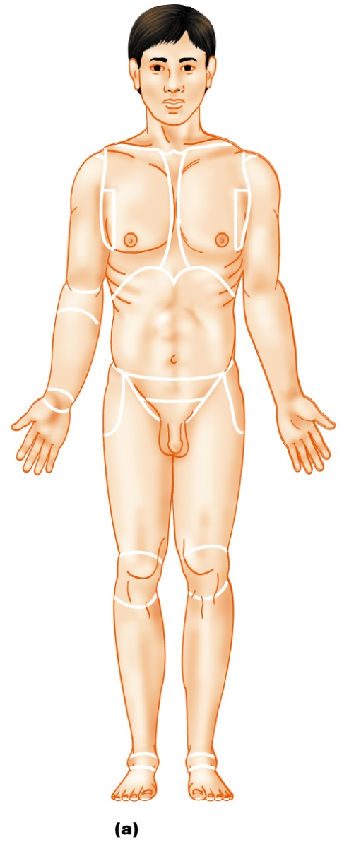
A. Anatomical Position & Directional Terms
anatomical position: body erect, feet together
palms face forward
thumbs point away from body
standard reference point

Slide 5
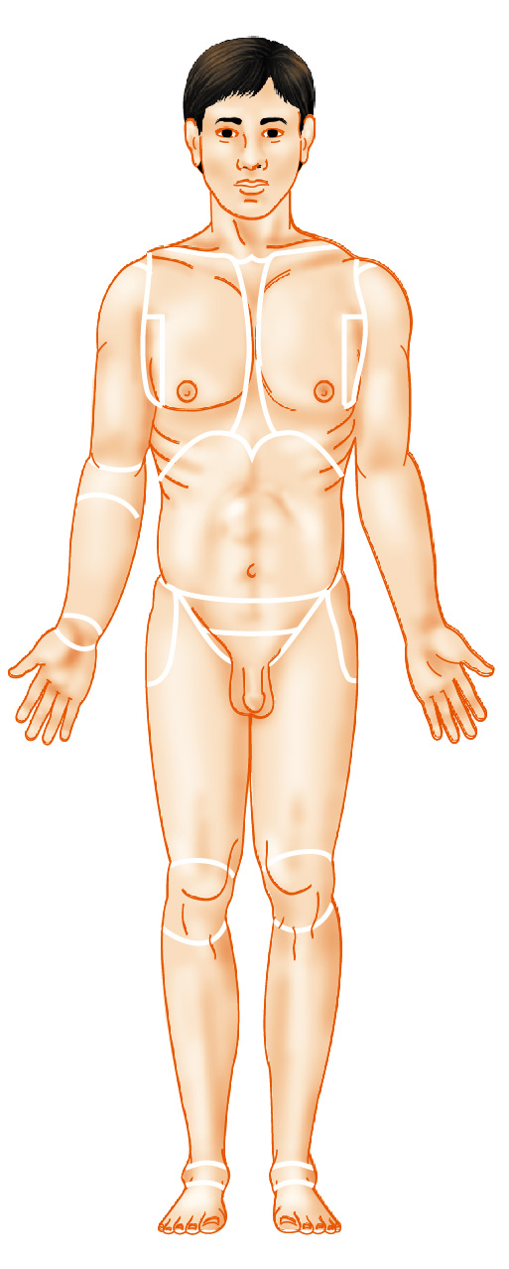
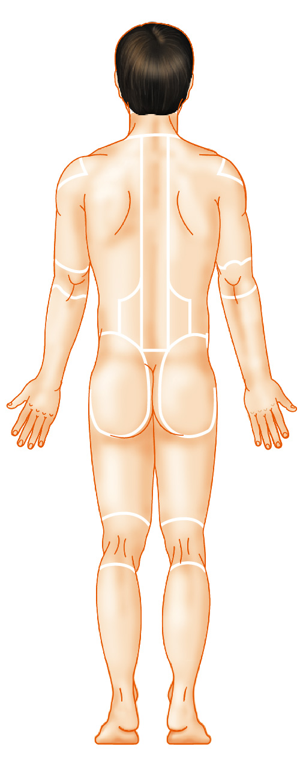
B. Regional Terms
Nasal (nose)
Frontal (forehead)
Oral (mouth)
Orbital (eye)
Cervical (neck)
Cephalic
(head)
Occipital (back of
head or base of skull)
Acromial
(point of shoulder)
Sternal
(breastbone)
Acromial
(point of shoulder)
Axillary (armpit)
Thoracic
(chest)
Vertebral
(spinal column)
Abdominal
(abdomen)
Scapular
(shoulder blade)
Brachial (arm)
Brachial (arm)
Antecubital
(front of elbow)
Dorsum or dorsal
(back)
Antebrachial
(forearm)
Umbilical
(navel)
Pelvic (pelvis)
Lumbar (loin)
Carpal (wrist)
Sacral
(between hips)
Coxal
(hip)
Gluteal (buttock)
Digital
(fingers)
Perineal
(region between
the anus and
external genitalia)
Inguinal
(groin)
Pubic (genital region)
Femoral
(thigh)
Femoral (thigh)
Patellar
(anterior knee)
Popliteal
(back of knee)
Fibular, or
peroneal
(side of leg)
Calcaneal (heel)
Tarsal (ankle)
Digital (toes)
(a) Anterior
(b) Posterior

Slide 6
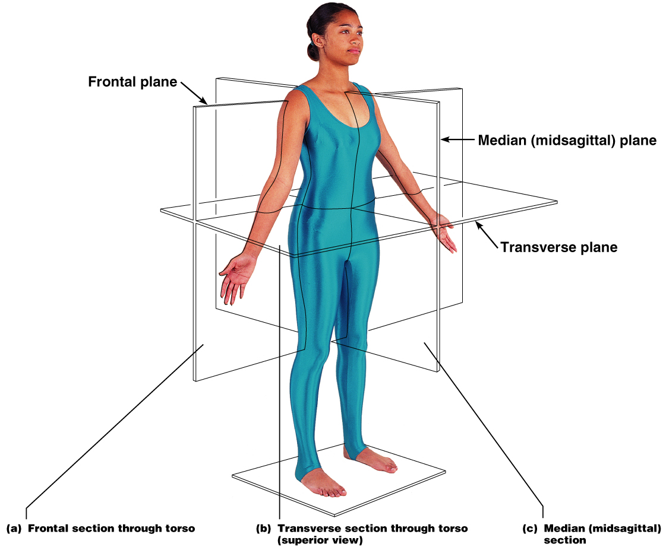
C. Body Planes & Sections
Sagittal
Midsagittal
Frontal
Transverse
Oblique

Slide 7
Body Cavities
Cranial cavity
(contains brain)
Dorsal
body
cavity
Thoracic
cavity
(contains
heart
and lungs)
Diaphragm
Vertebral cavity
(contains spinal
cord)
Abdominal cavity
(contains digestive
viscera)
Key:
Dorsal body cavity
Pelvic cavity
(contains bladder,
reproductive organs,
and rectum)
Ventral body cavity
(a) Lateral view
Figure 1.9a

Slide 8
Body Cavities
Cranial
cavity
Key:
Dorsal body cavity
Ventral body cavity
Vertebral
cavity
Superior
mediastinum
Thoracic
cavity
(contains
heart
and lungs)
Pleural
cavity
Pericardial
cavity within
the mediastinum
Diaphragm
Ventral
body cavity
(thoracic
and
abdomino-
pelvic
cavities)
Abdominal cavity
(contains digestive
viscera)
Abdomino-
pelvic
cavity
Pelvic cavity
(contains bladder,
reproductive organs,
and rectum)
(b) Anterior view
Figure 1.9b

Slide 9
Biochemistry
CHAPTER 2

Slide 10
particles in constant motion because of kinetic energy
liquids & gases, particles move randomly sometimes colliding with one another
reaction occurs when chemical bonds are formed, rearranged, or broken

Slide 11
A. Chemical Equations
reactants products

Slide 12
B. Patterns of Chemical Reactions
1. synthesis or combination reaction
*A + B -----> AB
*basis of constructive or anabolic activities - growth of body

Slide 13
2. decomposition reaction
*occurs when a molecule is broken down into smaller molecules or atoms

Slide 14
AB -----> A + B
*food is broken down for energy
*requires energy to break bond
*degradative or catabolic processes

Slide 15
3. exchange or displacement reactions
*bonds are made and broken
*AB + C ----> AC + B
*AB + CD -----> AD + CB

Slide 16
4. oxidation-reduction (redox) reactions
*hybrid reactions that can be classified as both decomposition & exchange

Slide 17
C. Reversibility of Chemical Reactions
indicated by a double arrow
chemical equilibrium
arrows may differ in length, longer arrow indicates major direction of reaction

Slide 18
D. Factors Influencing Rate of Chemical Reactions
particles must collide with enough force and proper alignment to overcome repulsion of their electrons
1. temperature
2. particle size
3. concentration

Slide 19
4. catalysts
substances that increase the rate of reactions without themselves becoming chemically changed or part of product
enzymes: proteins

Slide 20
VII. ORGANIC COMPOUNDS
Contain carbon
Most are covalently bonded
ATP
CARBOHYDRATES
LIPIDS
PROTEINS
NUCLEIC ACIDS

Slide 21
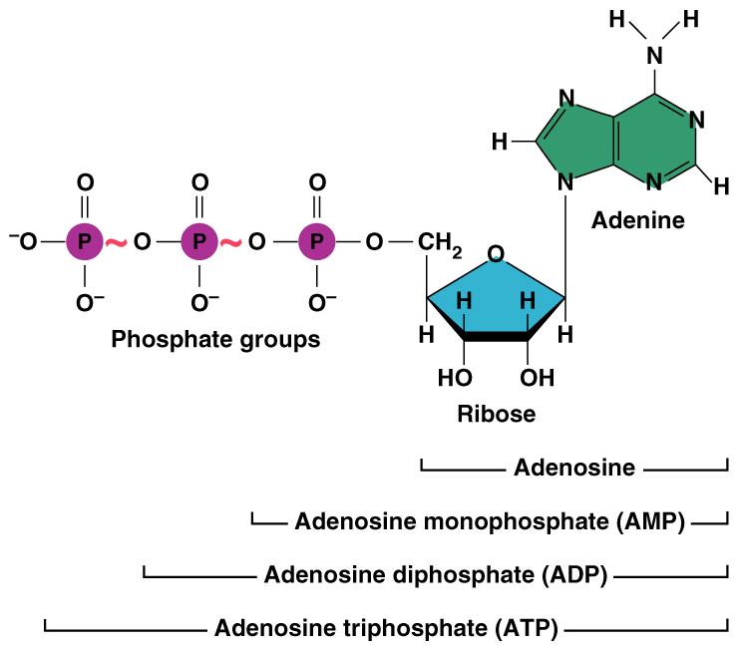
Adenosine Triphosphate
ATP
energy stored as small “packets” in bonds of ATP
breaking the high energy phosphate bonds releases energy for cellular events

Slide 22
Called energy currency molecule
easy to store
releases just right amount of energy - not excessive
single system that can be used by all cells in body

Slide 23
ADP: adenosine diphosphate
ATP ADP + P_{i} + energy
P_{i}: inorganic phosphate group
H₂O
H₂O

Slide 24
CARBOHYDRATES
- Include sugars and starches
- Classified according to size
Monosaccharides
Disaccharides
Polysaccharides

Slide 25
Carbohydrates continued

Slide 26
LIPIDS
Insoluble in water
Common lipids in the human body
Neutral fats (triglycerides)
Found in fat deposits
Composed of fatty acids and glycerol
Source of stored energy
Phospholipids
Form cell membranes
Steroids
Include cholesterol – Used to build bile salts, vitamin D, and some hormones

Slide 27
LIPIDS Cont.

Slide 28
LIPIDS Continued

Slide 29
PROTEINS
Made of amino acids
Account for over half of the body’s organic matter
Provides for construction materials for body tissues
Plays a vital role in cell function
Act as enzymes, hormones, and antibodies
Enzymes
- Act as biological catalysts
- Increase the rate of chemical reactions

Slide 30
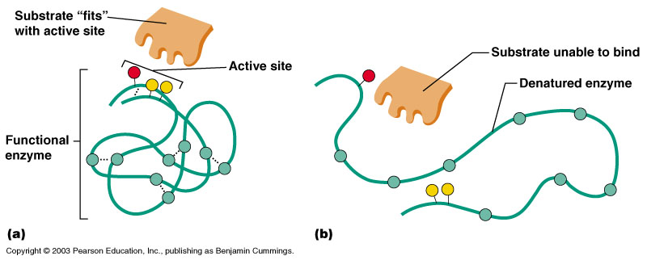
PROTIENS Continued
Enzymes….

Slide 31
NUCLEIC ACIDS
Provide blueprint of life
DNA and RNA
Nucleotide Bases
A = Adenine
G = Guanine
C = Cytosine
T = Thymine
U = Uracil

Slide 32
NUCLEIC ACIDS Continued

