Slide 1
The Human Body: An Orientation
CHAPTER 1

Slide 2
I. An Overview of Anatomy & Physiology
Anatomy: study of structure of body parts & their relationship to one another

Slide 3
Physiology: how the body parts work & carry out life-sustaining activities

Slide 4
Principle of Complementarity of Structure & Function
what a structure can do depends on its specific form
Function always reflects structure

Slide 5
II. Hierarchy of Structural Organization
figure 1.1 p. 3
atoms: tiny building blocks of matter
molecules: water, sugar, proteins...

Slide 6
cells: smallest units of living things
tissues: consist of groups of similar cells that have a common function

Slide 7
organ: structure composed of at least two tissue types (usually 4) that perform a specific function for the body
organ system: organs that cooperate & work closely together to accomplish a common purpose

Slide 8
organism: sum total of all structural levels working in unison to promote life

Slide 9
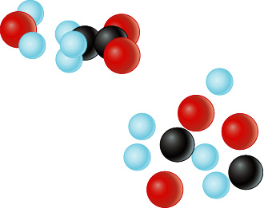
Levels of Structural Organization
Smooth muscle cell
Molecules
2
Cellular level
Cells are made up of
molecules.
Atoms
1
Chemical level
Atoms combine to
form molecules.
Smooth
muscle
tissue
3
Tissue level
Tissues consist of
similar types of cells.
Heart
Cardiovascular
system
Blood
vessels
Epithelial
tissue
Smooth
muscle
tissue
Blood
vessel
(organ)
6
Organismal level
The human organism
is made up of many
organ systems.
Connective
tissue
4
Organ level
Organs are made up
of different types
of tissues.
5
Organ system level
Organ systems consist of
different organs that
work together closely.
Figure 1.1

Slide 10
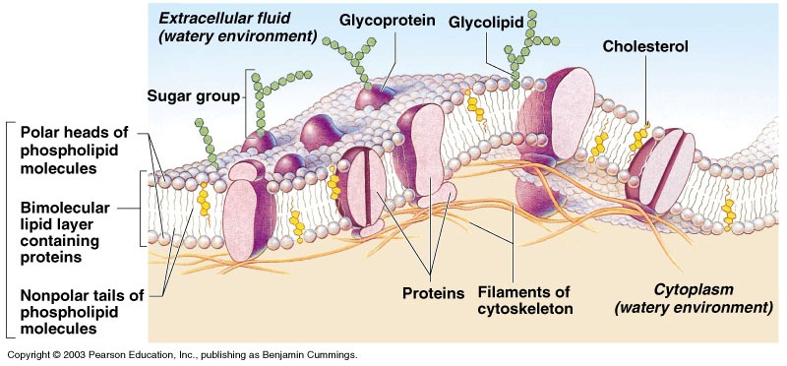
III. Necessary Life Functions
A. Maintenance of Boundaries
so internal environment remains distinct from external environment surrounding it
Cellular – plasma membrane
Organismal – skin

Slide 11
B. Movement – locomotion, propulsion (peristalsis), and contractility
C. Responsiveness – ability to sense changes in the environment and respond to them
D. Digestion – breakdown of ingested foodstuffs
E. Metabolism – all the chemical reactions that occur in the body
F. Excretion – removal of wastes from the body

Slide 12
G. Reproduction
cellular or organismal level
H. Growth
increase in size of a body part or organism
increase in number of cells

Slide 13
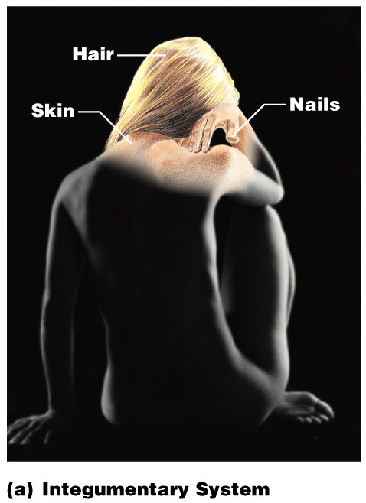
Integumentary System
Forms the external body covering
Composed of the skin, sweat glands, oil glands, hair, and nails
Protects deep tissues from injury and synthesizes vitamin D
Figure 1.3a

Slide 14
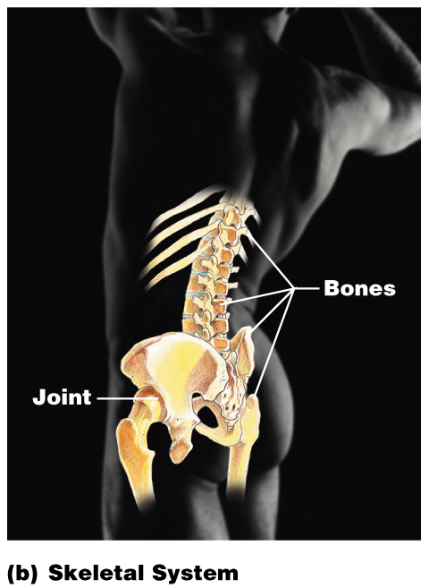
Skeletal System
Composed of bone, cartilage, and ligaments
4 Functions:
Protect and Support
Attachment for muscle
Blood cell formation
Mineral storage
Figure 1.3b

Slide 15
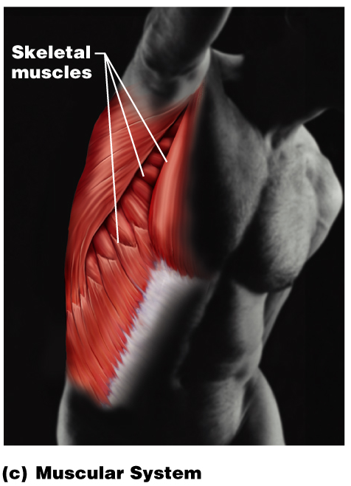
Muscular System
Composed of muscles and tendons
Body movement
Maintains posture
Produces heat
Figure 1.3c

Slide 16
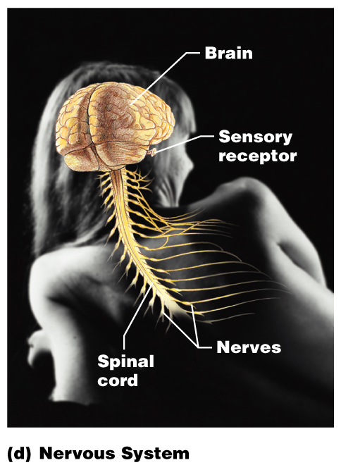
Nervous System
Composed of the brain, spinal column, and nerves
Is the fast-acting control system of the body
Responds to stimuli by activating muscles and glands (effectors)
Figure 1.3d

Slide 17
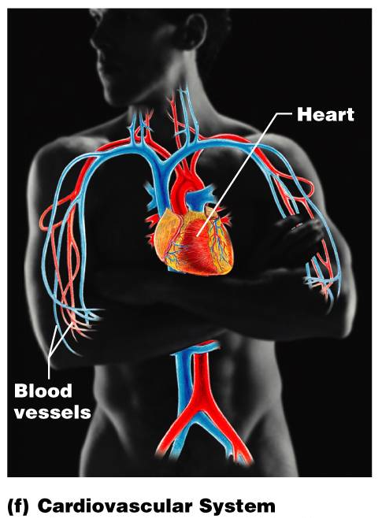
Cardiovascular System
Composed of the heart and blood vessels
The heart pumps blood
The blood vessels transport blood throughout the body
Figure 1.3f

Slide 18
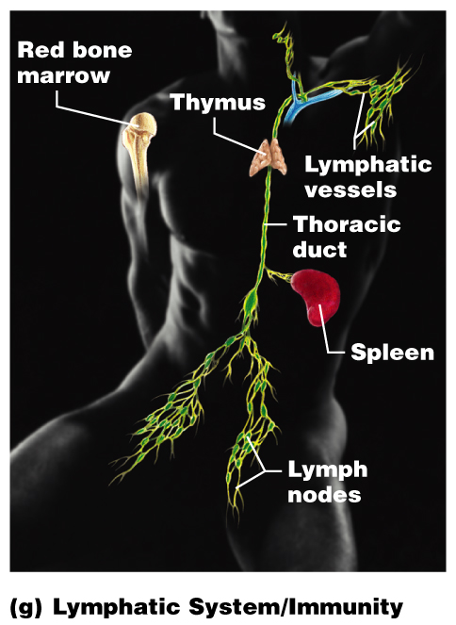
Lymphatic System
Sister system to circulatory
Picks up fluid leaked from blood vessels and returns it to blood
Disposes of debris in the lymphatic stream
Houses white blood cells involved with immunity
Figure 1.3g

Slide 19
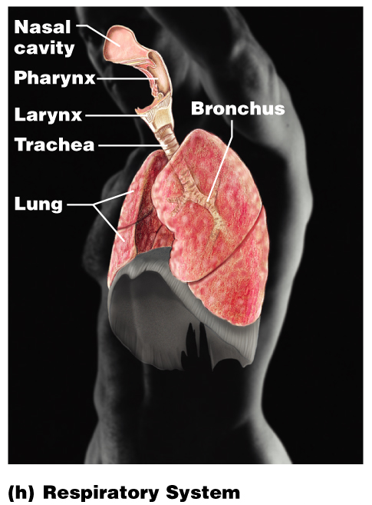
Respiratory System
Composed of the nasal cavity, pharynx, trachea, bronchi, and lungs
Keeps blood supplied with oxygen and removes carbon dioxide
Figure 1.3h

Slide 20
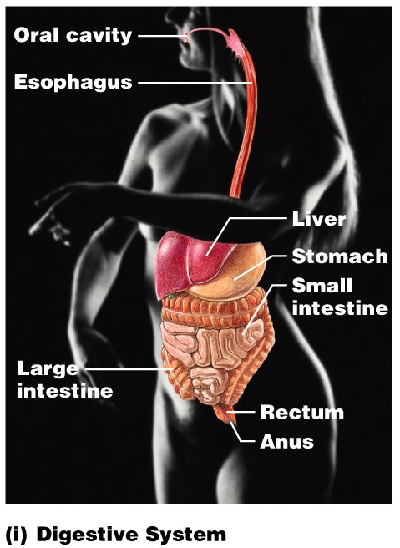
Digestive System
Alimentary canal and accessory organs
Breaks down food into absorbable units that enter the blood
Eliminates indigestible foodstuffs as feces
Figure 1.3i

Slide 21
Urinary System
Composed of kidneys, ureters, urinary bladder, and urethra
Eliminates nitrogenous wastes from the body
Regulates water, electrolyte, and pH balance of the blood
Figure 1.3j

Slide 22
Male Reproductive System
Testes produce sperm and male sex hormones
Ducts and glands deliver sperm to the female reproductive tract
Figure 1.3k

Slide 23
Female Reproductive System
Ovaries produce eggs and female sex hormones
Provide sites for fertilization and development of the fetus
Figure 1.3l

Slide 24
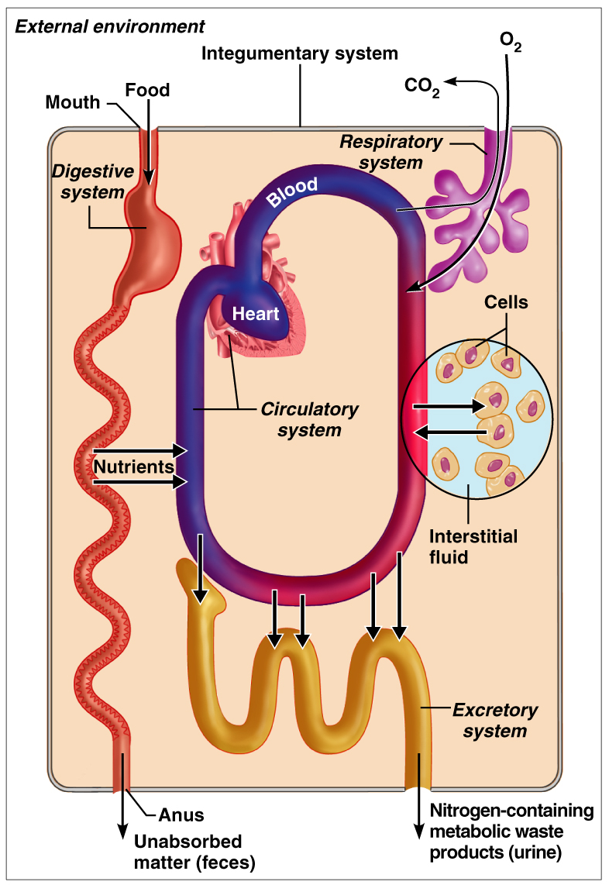
Organ Systems Interrelationships
Examples:
Nutrients and oxygen are distributed by the blood
Metabolic wastes are eliminated by the urinary and respiratory systems
Figure 1.2

Slide 25
IV. Homeostasis
ability to maintain relatively stable internal conditions even though there is continuous change in outside world

Slide 26
A. Homeostatic Control Mechanisms
Variables produce a change in the body
Three components:
Receptor – monitors the environments and responds to changes (stimuli)
Control center – determines the set point at which the variable is maintained
Effector – provides the means to respond to stimuli

Slide 27
B. Negative Feedback Mechanisms
most feedback mechanisms are negative
The output shuts off the original stimulus
Ex. Regulation of room temp.

Slide 28
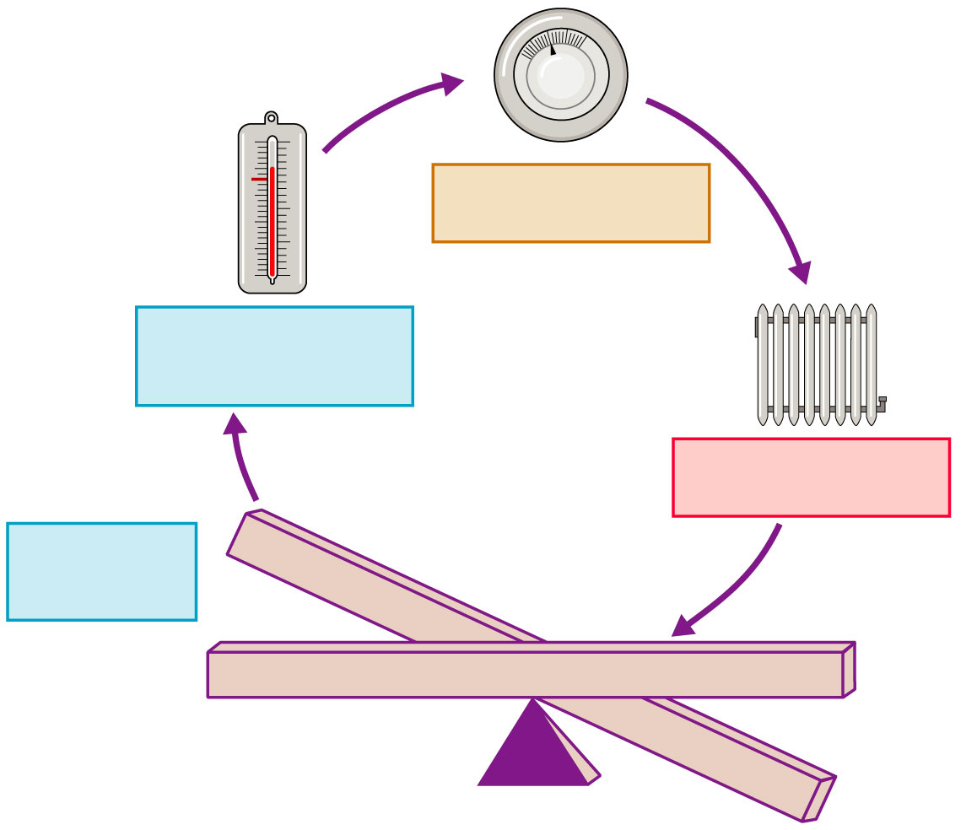
Signal
wire turns
heater off
Set
point
Control center
(thermostat)
Stimulus:
dropping room
temperature
Receptor-sensor
(thermometer
In thermostat)
Heater
off
Effector
(heater)
Stimulus:
rising room
temperature
Response;
temperature
drops
Balance
Figure 1.5

Slide 29
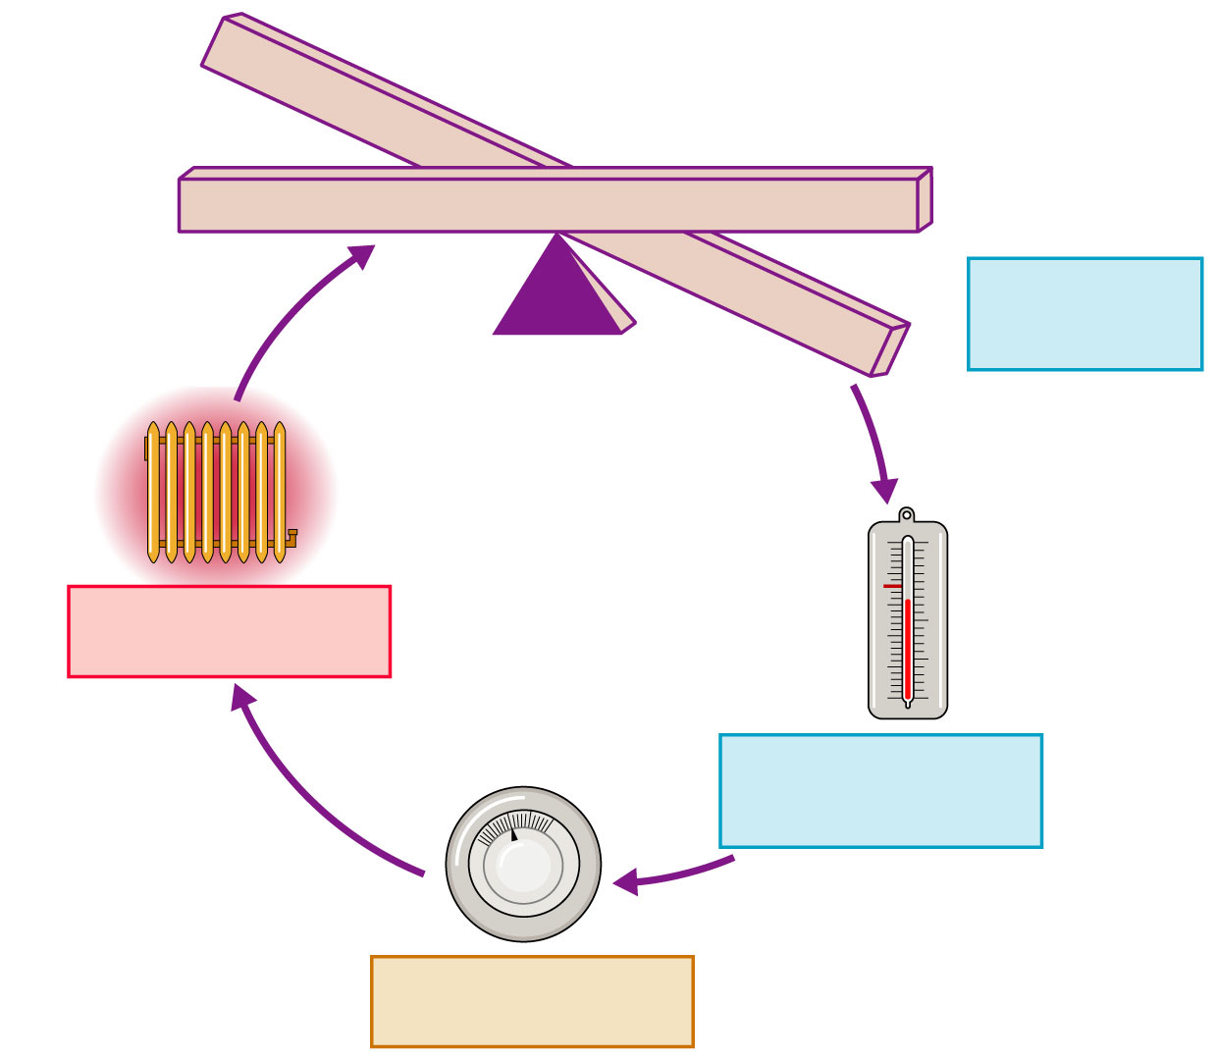
Balance
Response;
temperature
rises
Stimulus:
dropping room
temperature
Heater
on
Set
point
Effector
(heater)
Receptor-sensor
(thermometer in
Thermostat)
Signal
wire turns
heater on
Control center
(thermostat)
Figure 1.5

Slide 30
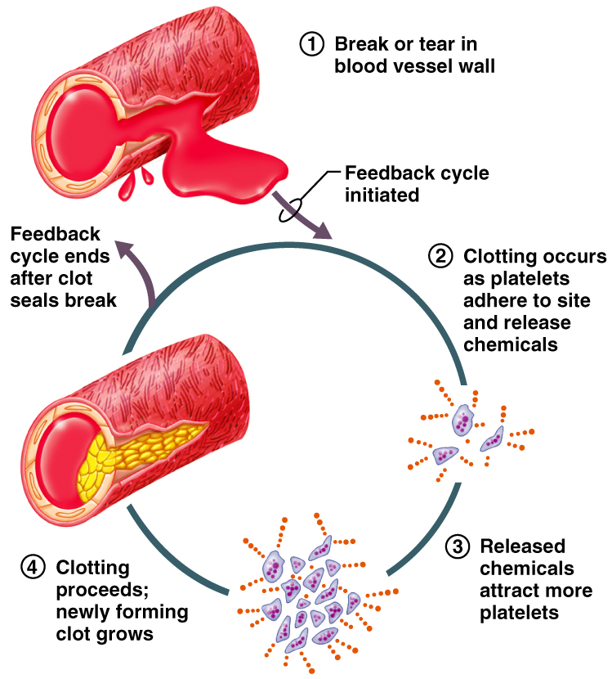
C. Positive Feedback Mechanisms
feedback is “positive” because change occurs in same direction as initial disturbance
clotting of blood, oxytocin during labor

Slide 31
D. Homeostatic Imbalance
reason for most diseases
as we age organs & organ systems become less efficient
greater risk for illness
Overwhelming the usual negative feedback mechanisms allows destructive positive feedback mechanisms to take over

