Slide 1
The Autonomic Nervous System

Slide 2
Autonomic Nervous System (ANS)
The ANS consists of motor neurons that:
Innervate smooth and cardiac muscle and glands
Make adjustments to ensure optimal support for body activities
Operate via subconscious control
Have viscera as most of their effectors

Slide 3
Divisions of the ANS
Sympathetic division (thoracolumbar, “fight or flight”)
Thoracic and lumbar segments
Parasympathetic division (craniosacral, “rest and repose”)
Preganglionic fibers leaving the brain and sacral segments
Enteric nervous system (ENS)
May work independently

Slide 4
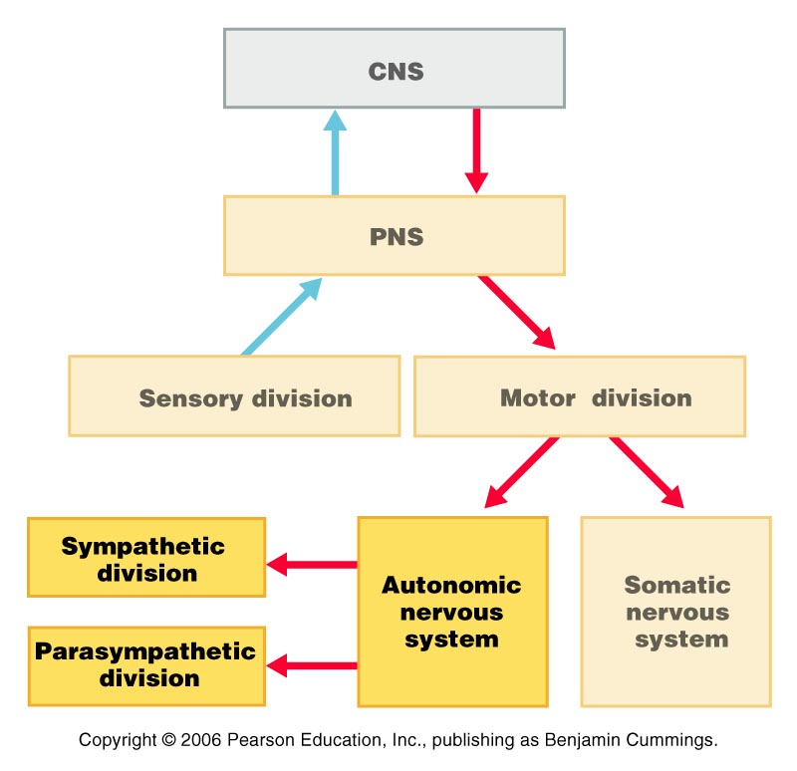
ANS in the Nervous System

Slide 5
Sympathetic and Parasympathetic
Often they have opposing effects
May work independently
May work together each one controlling one stage of the process

Slide 6
ANS Versus Somatic Nervous System (SNS)
The ANS differs from the SNS in the following three areas
Effectors
Efferent pathways
Target organ responses

Slide 7
Effectors
The effectors of the SNS are skeletal muscles
The effectors of the ANS are cardiac muscle, smooth muscle, and glands

Slide 8
Efferent Pathways
Heavily myelinated axons of the somatic motor neurons extend from the CNS to the effector
Axons of the ANS are a two-neuron chain
The preganglionic (first) neuron has a lightly myelinated axon
The ganglionic (second) neuron extends to an effector organ

Slide 9
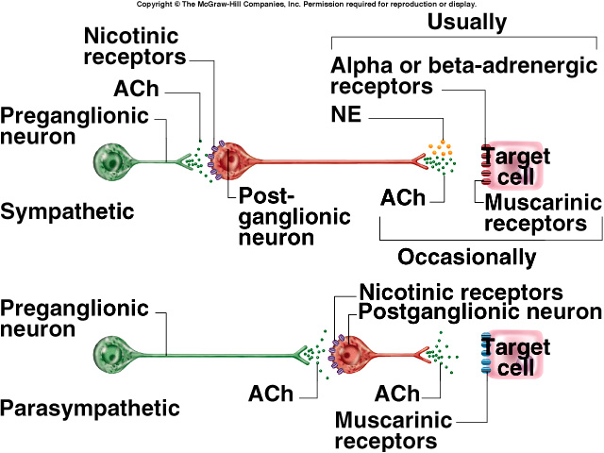
Neurotransmitters and Receptors

Slide 10
Neurotransmitter Effects
All somatic motor neurons release Acetylcholine (ACh), which has an excitatory effect
In the ANS:
Preganglionic fibers release ACh
Postganglionic fibers release norepinephrine or ACh and the effect is either stimulatory or inhibitory
ANS effect on the target organ is dependent upon the neurotransmitter released and the receptor type of the effector

Slide 11
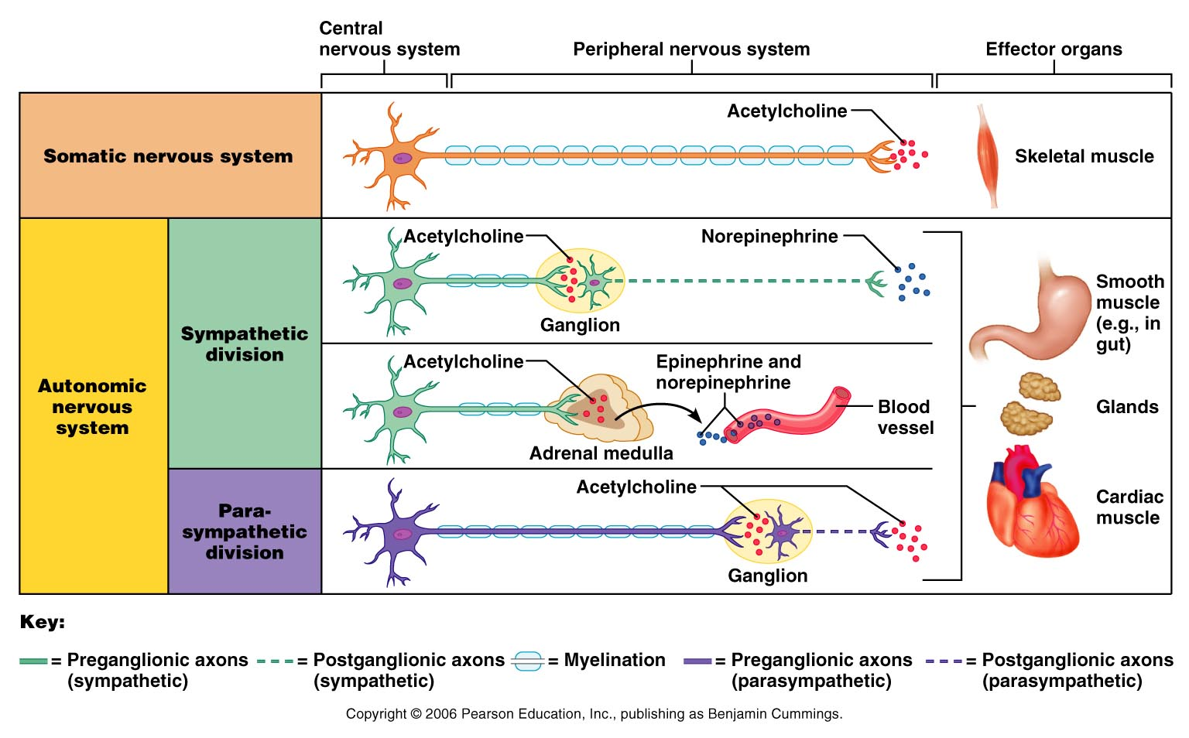
Comparison of Somatic and Autonomic Systems

Slide 12
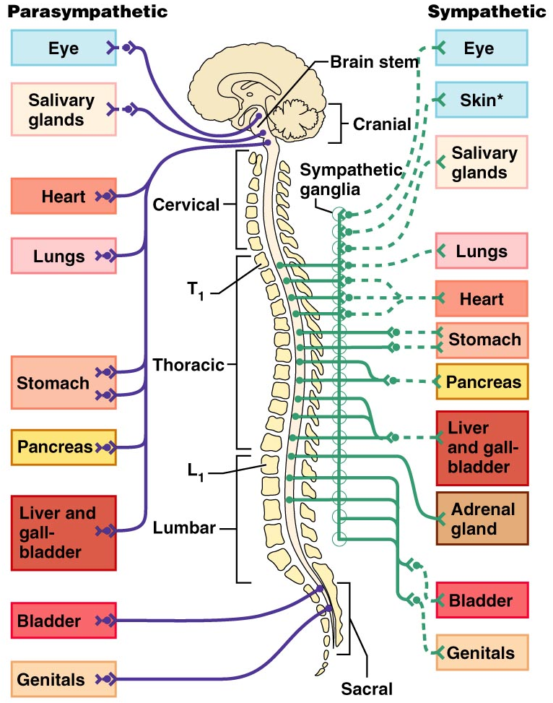

Slide 13
Sympathetic division anatomy
Preganglionic neurons between segments T1 and L2 – lateral gray horn of spinal cord
Preganglionic fibers
Short
Travel in the ventral root and spinal nerve
Ganglionic neurons in ganglia near vertebral column
Specialized neurons in adrenal glands
Postganglionic fibers
Long fibers

Slide 14
Sympathetic ganglia
Sympathetic chain ganglia (paravertebral ganglia)
Collateral ganglia (prevertebral ganglia)
Adrenal medulla

Slide 15
The Organization of the Sympathetic Division

Slide 16
Organization and anatomy of the sympathetic division
Segments T1-L2, ventral roots give rise to myelinated white ramus
Leads to sympathetic chain ganglia

Slide 17
Postganglionic fibers of the sympathetic ganglia
Some fibers will return to the spinal nerve through a gray ramus and will innervate skin, blood vessels, sweat glands, adipose tissue, arrector pili muscle
Some fibers will form sympathetic nerves that will innervate thoracic organs
Go directly to innervate the thoracic organs

Slide 18
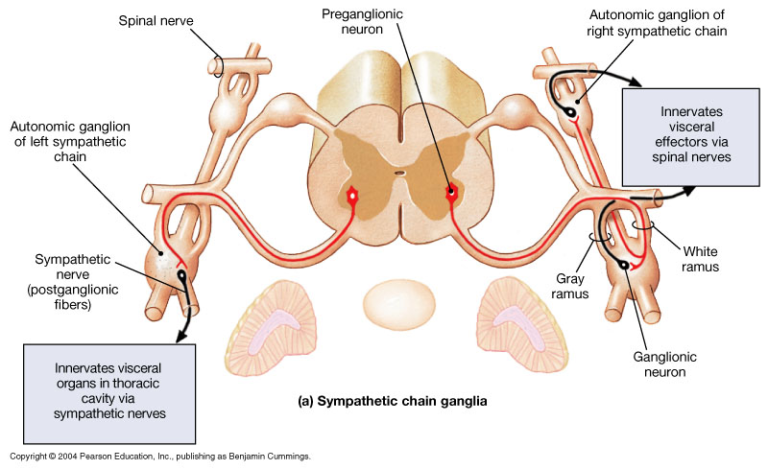
Sympathetic Pathways-chain ganglia

Slide 19
Collateral ganglia
Preganglionic fibers will pass through the sympathetic chain without synapsing
Preganglionic fibers will synapse within collateral ganglia
Splanchnic nerves will synapse on one of the four collateral ganglions

Slide 20
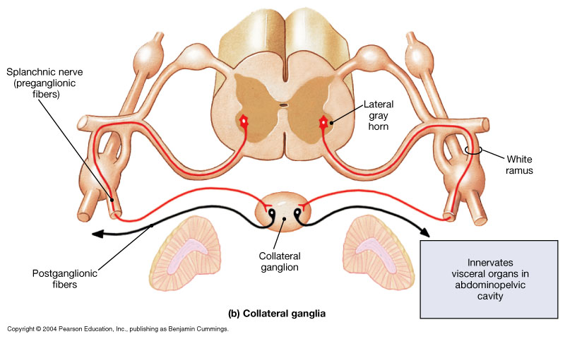
Sympathetic Pathways – collateral ganglia

Slide 21
Collateral ganglia
Celiac ganglion
Postganglionic fibers innervates stomach, liver, gall bladder, pancreas, spleen
Superior mesenteric ganglion
Posganglinic fibers innervates small intestine and initial portion of large intestine

Slide 22
Collateral ganglia
Inferior mesenteric ganglion
Postganglionic fibers innervate the final portion of large intestine
Inferior hypogastric
Posganglionic fibers innervates urinary bladder , sex organs

Slide 23
Adrenal medulla
Preganglionic fibers will pass through sympathetic ganglia without synapsing
Preganglionic fibers will synapse on adrenal medulla
Adrenal medulla will secrete
Epinephrine
Norepinephrine

Slide 24
Adrenal medulla
Neurotransmitter will go into general circulation
Their effects last longer than those produced by direct sympathetic innervation

Slide 25
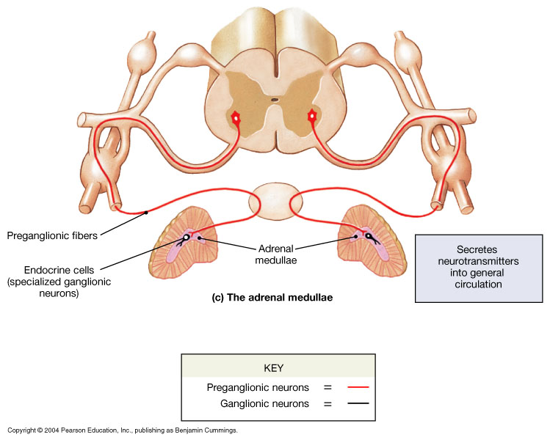
Sympathetic Pathways- adrenal medulla

Slide 26
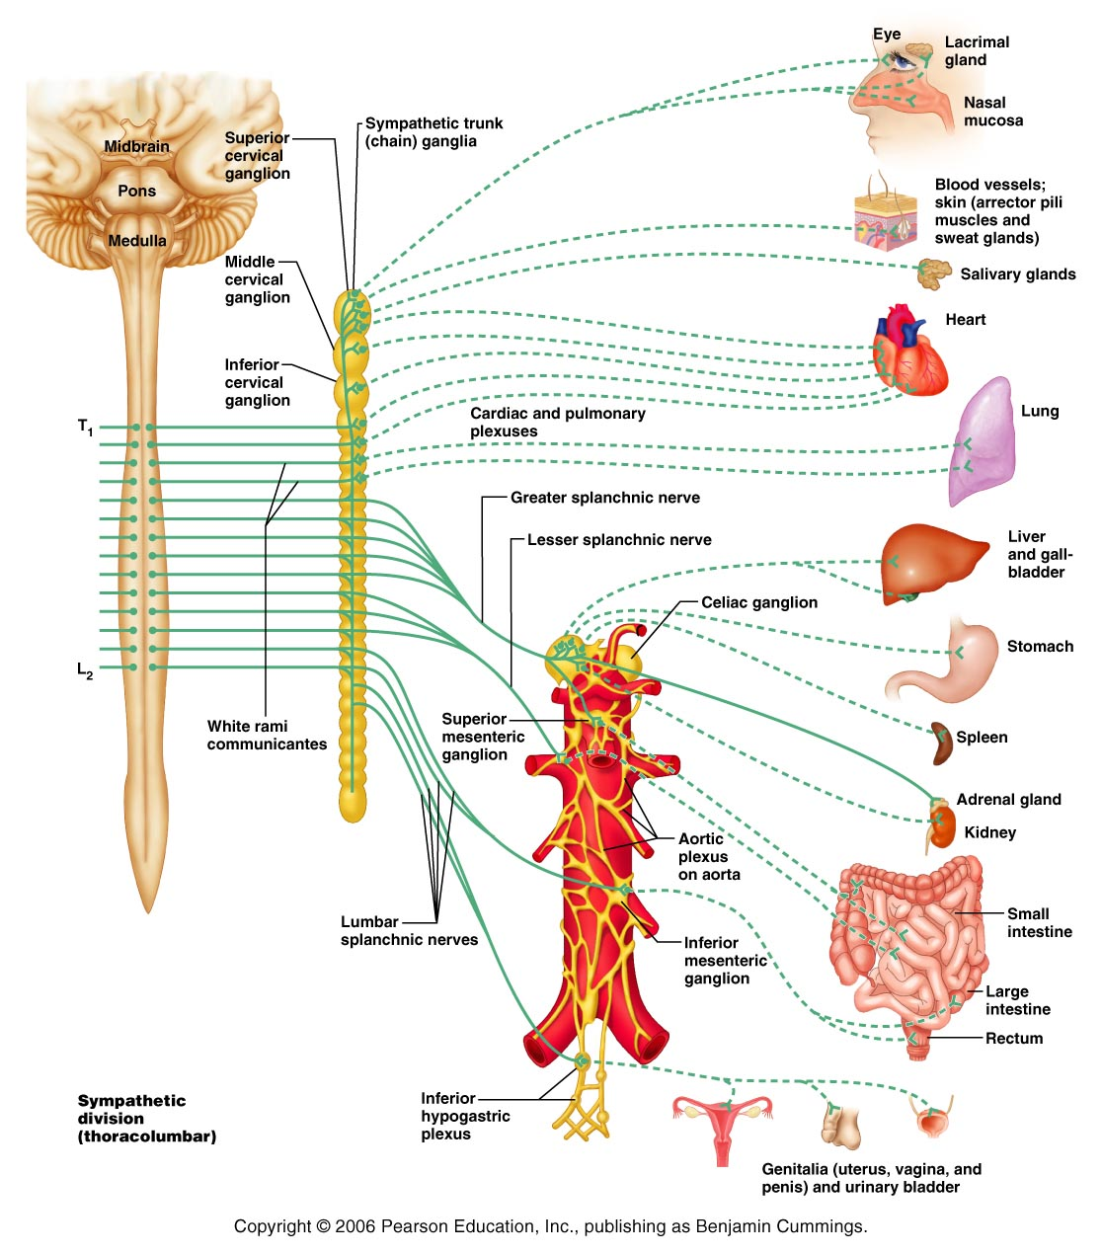

Slide 27
Role of the Sympathetic Division
The sympathetic division is the “fight-or-flight” system
Involves E activities – exercise, emergency
Promotes adjustments during exercise
Blood flow to organs is reduced, flow to muscles is increased

Slide 28
Role of the Sympathetic Division
Its activity is illustrated by a person who is threatened
Heart rate increases, and breathing is rapid and deep
The skin is cold and sweaty, and the pupils dilate

Slide 29
Parasympathetic division (craniosacral division)
Preganglionic neurons in the brainstem(nuclei of cranial nerves III, VII, IX, X) and sacral segments of spinal cord (S2-S4)
Ganglionic neurons in peripheral ganglia located within or near target organs
Terminal ganglion
Intramural ganglion

Slide 30
The Organization of the Parasympathetic Division of the ANS

Slide 31
Parasympathetic Division Outflow
Pre-ganglionic neurons | Pre-ganglionic fibers | Ganglion | Effector Organ(s)
Nuclei of III | Oculomotor (III) | Ciliary | Eye
Nuclei of VII | Facial (VII) | Pterygopalatine | Nasal, and lacrimal glands
 |  | Submandibular | Salivary glands
Nuclei of IX | Glossopharyngeal (IX) | Otic | Salivary glands
Nuclei of X | Vagus (X) | Intramural or terminal | Thoracic and abdominal organs
Lateral horn (S2-S4) | Pelvic Nerves | Intramural or terminal | Pelvic organs

Slide 32
Organization and anatomy of the parasympathetic division
Preganglionic fibers leave the brain as cranial nerves III, VII, IX, X
Postganglionic fibers of the upper 4 ganglia travel in the trigeminal nerve
Cranial nerve X provides 75% of the parasympathetic outflow
Sacral neurons form the pelvic nerves

Slide 33
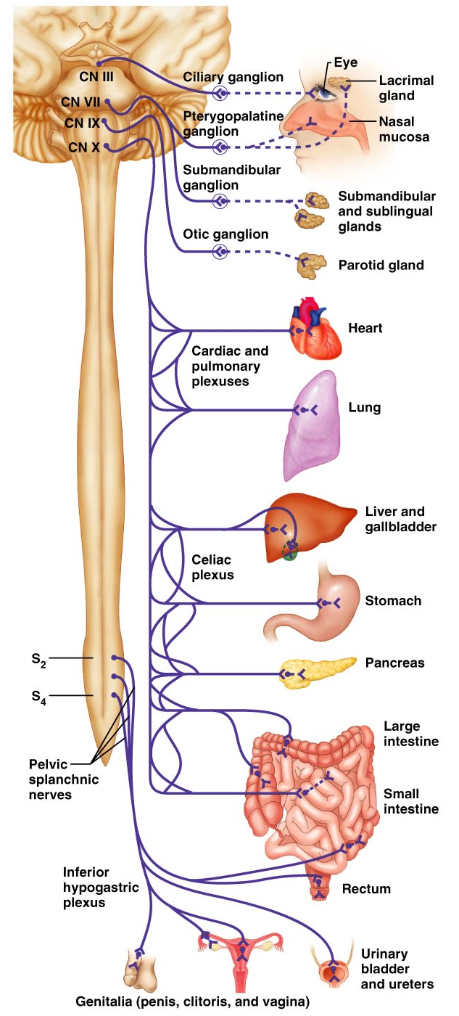

Slide 34
Parasympathetic activation
Effects produced by the parasympathetic division
relaxation
food processing
energy absorption
Pupil constriction
Constriction of respiratory passageway
Decrease heart rate and blood pressure
Stimulates defecation and urination

Slide 35
Summary: The Anatomical Differences between the Sympathetic and Parasympathetic Divisions

Slide 36
The Autonomic Nervous System
P A R T B

Slide 37
Sensory Visceral Neurons
Are found in:
Sensory ganglia of cranial nerves
Dorsal root ganglia
Sympathetic ganglia
Afferent visceral fibers are found in:
Cranial nerves VII, IX, X
Autonomic nerves
Spinal nerves

Slide 38
Visceral Reflexes
Visceral reflexes have the same elements as somatic reflexes
They are always polysynaptic pathways

Slide 39
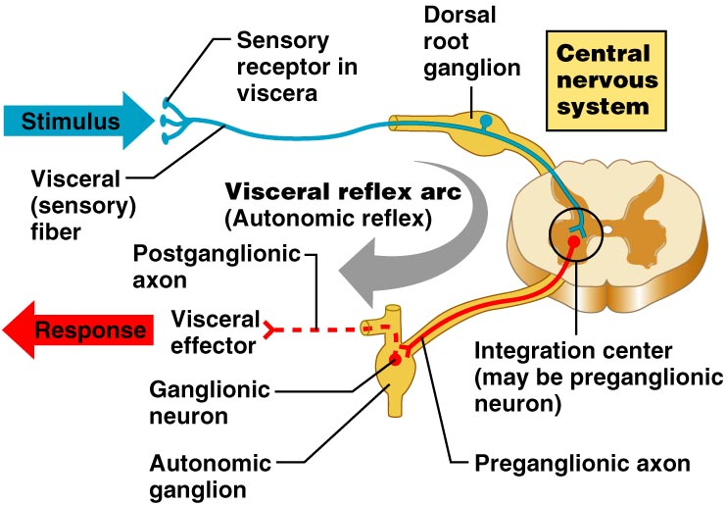
Visceral Reflexes

Slide 40
Referred Pain
Pain stimuli arising from the viscera are perceived as somatic in origin
This may be due to the fact that visceral pain afferents travel along the same pathways as somatic pain fibers

Slide 41
Referred Pain

Slide 42
Neurotransmitters and Receptors
Acetylcholine (ACh) and norepinephrine (NE) are the two major neurotransmitters of the ANS
ACh is released by all preganglionic axons and all parasympathetic postganglionic axons
Cholinergic fibers – ACh-releasing fibers

Slide 43
Neurotransmitters and Receptors
Adrenergic fibers – sympathetic postganglionic axons that release NE
Neurotransmitter effects can be excitatory or inhibitory depending upon the receptor type

Slide 44
Neurotransmitters and Receptors

Slide 45
Neurotransmitters and parasympathetic functions
All parasympathetic fibers release ACh
Short-lived response as ACh is broken down by AChE and tissue cholinesterase
Postsynaptic membranes have two kinds of receptors: muscarinic and nicotinic

Slide 46
Neurotransmitters and parasympathetic functions
Muscarinic
Parasympathetic target organs
Postganglionic cholinergic fibers
Cardiac muscle
Smooth muscle
Excitatory or inhibitory effects
Depends on the receptor type of the target organ

Slide 47
Nicotinic Receptors
Nicotinic receptors are found on:
Surface of skeletal muscles
All ganglionic neurons of both sympathetic and parasympathetic divisions
The hormone-producing cells of the adrenal medulla
The effect of ACh binding to nicotinic receptors is always stimulatory by opening Na channels

Slide 48
Adrenergic Receptors
The two types of adrenergic receptors are alpha and beta
Each type has two or three subclasses (α₁, α₂, β₁, β₂ , β₃)

Slide 49
Adrenergic Receptors
Alpha 1
Most sympathetic target organs
Constrict blood vessels of skin, mucosa, abdominal viscera, kidney, salivary glands
Dilates pupil
Constrict involuntary sphincters
Excitatory

Slide 50
Adrenergic Receptors
Alpha 2
Inhibits insulin secretion by the pancreas
Promotes blood clotting
Generally is inhibitory

Slide 51
Adrenergic receptors
Beta 1
Heart, kidney
Excitatory
Beta 2
Respiratory system, GI system, blood vessels,etc
Inhibitory

Slide 52
Adrenergic receptors
Beta 3
Adipose tissue
Excitatory

Slide 53
Effects of Drugs
Atropine – blocks parasympathetic effects
Neostigmine – inhibits acetylcholinesterase and is used to treat myasthenia gravis
Tricyclic antidepressants – prolong the activity of NE on postsynaptic membranes

Slide 54
Effects of Drugs
Over-the-counter drugs for colds, allergies, and nasal congestion – stimulate α-adrenergic receptors
Beta-blockers – attach mainly to β₁ receptors and reduce heart rate and prevent arrhythmias

Slide 55
Interactions of the Autonomic Divisions
Most visceral organs are innervated by both sympathetic and parasympathetic fibers
This results in dynamic antagonisms that precisely control visceral activity
Sympathetic fibers increase heart and respiratory rates, and inhibit digestion and elimination
Parasympathetic fibers decrease heart and respiratory rates, and allow for digestion and the discarding of wastes

Slide 56
Sympathetic Tone
The sympathetic division controls blood pressure and keeps the blood vessels in a continual state of partial constriction
This sympathetic tone (vasomotor tone):
Constricts blood vessels and causes blood pressure to rise as needed
Prompts vessels to dilate if blood pressure is to be decreased
Alpha-blocker drugs interfere with vasomotor fibers and are used to treat hypertension

Slide 57
Parasympathetic Tone
Parasympathetic tone:
Slows the heart
Dictates normal activity levels of the digestive and urinary systems
The sympathetic division can override these effects during times of stress
Drugs that block parasympathetic responses increase heart rate and block fecal and urinary retention

Slide 58
Cooperative Effects
ANS cooperation is best seen in control of the external genitalia
Parasympathetic fibers cause vasodilation and are responsible for erection of the penis and clitoris
Sympathetic fibers cause ejaculation of semen in males and reflex contraction of a female’s vagina

Slide 59
Unique Roles of the Sympathetic Division
Regulates many functions not subject to parasympathetic influence
These include the activity of the adrenal medulla, sweat glands, arrector pili muscles, kidneys, and most blood vessels
The sympathetic division controls:
Thermoregulatory responses to heat
Release of renin from the kidneys
Metabolic effects

Slide 60
Thermoregulatory Responses to Heat
Applying heat to the skin causes reflex dilation of blood vessels
Systemic body temperature elevation results in widespread dilation of blood vessels
This dilation brings warm blood to the surface and activates sweat glands to cool the body
When temperature falls, blood vessels constrict and blood is retained in deeper vital organs

Slide 61
Release of Renin from the Kidneys
Sympathetic impulses activate the kidneys to release the hormone renin.

Slide 62
Metabolic Effects
The sympathetic division promotes metabolic effects that are not reversed by the parasympathetic division
Increases the metabolic rate of body cells
Raises blood glucose levels
Mobilizes fat as a food source
Stimulates the reticular activating system (RAS) of the brain, increasing mental alertness

Slide 63
Localized Versus Diffuse Effects
The parasympathetic division exerts short-lived, highly localized control
The sympathetic division exerts long-lasting, diffuse effects

Slide 64
Effects of Sympathetic Activation
Sympathetic activation is long-lasting because NE:
Is inactivated more slowly than ACh
Is an indirectly acting neurotransmitter, using a second-messenger system
And epinephrine are released into the blood and remain there until destroyed by the liver

Slide 65
Levels of ANS Control
The hypothalamus is the main integration center of ANS activity
Subconscious cerebral input via limbic lobe connections influences hypothalamic function
Other controls come from the cerebral cortex, the reticular formation, and the spinal cord

Slide 66
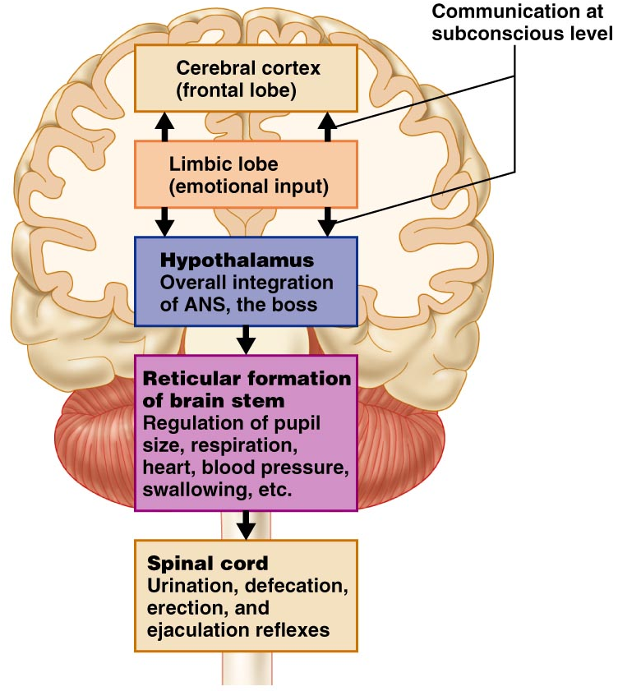
Levels of ANS Control

Slide 67
Hypothalamic Control
Centers of the hypothalamus control:
Heart activity and blood pressure
Body temperature, water balance, and endocrine activity
Emotional stages (rage, pleasure) and biological drives (hunger, thirst, sex)
Reactions to fear and the “fight-or-flight” system

Slide 68
Embryonic Development of the ANS
Preganglionic neurons are derived from the embryonic neural tube
ANS structures in the PNS derive from the neural crest
Nerve growth factor (NGF) is a protein secreted by target cells that aids in the development of ANS pathways

Slide 69
Developmental Aspects of the ANS
During youth, ANS impairments are usually due to injury
In old age, ANS efficiency decreases, resulting in constipation, dry eyes, and orthostatic hypotension
Orthostatic hypotension is a form of low blood pressure that occurs when sympathetic vasoconstriction centers respond slowly to positional changes

