Slide 1
2. Stratified: 2 or more layer of cells, used for protection
Squamous: skin, mouth, esophagus, vagina
Cuboidal: sweat, mammary & salivary glands
Columnar: rare, male urethra

Slide 2
Number of layers
Shape
Figure 4.1a

Slide 4
3. Pseudostratified: single layer of different heights of cells
function: secretion
location: glands, respiratory tract
4. Transitional: resembles stratified, cuboidal & columnar
function: ability to stretch
location: urinary bladder

Slide 5
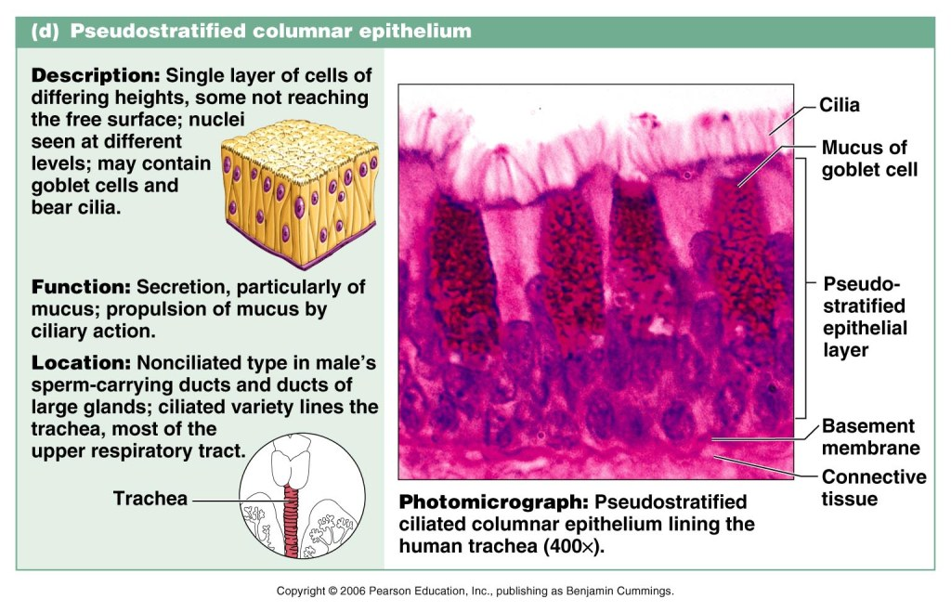

Slide 7
B. Glandular Epithelia
Endocrine Glands: ductless glands produce hormones and secrete to blood stream
Exocrine Glands: (more numerous) secrete products through ducts onto or into a body surface
salivary glands
mammary glands
Mucous glands
Sweat glands

Slide 8
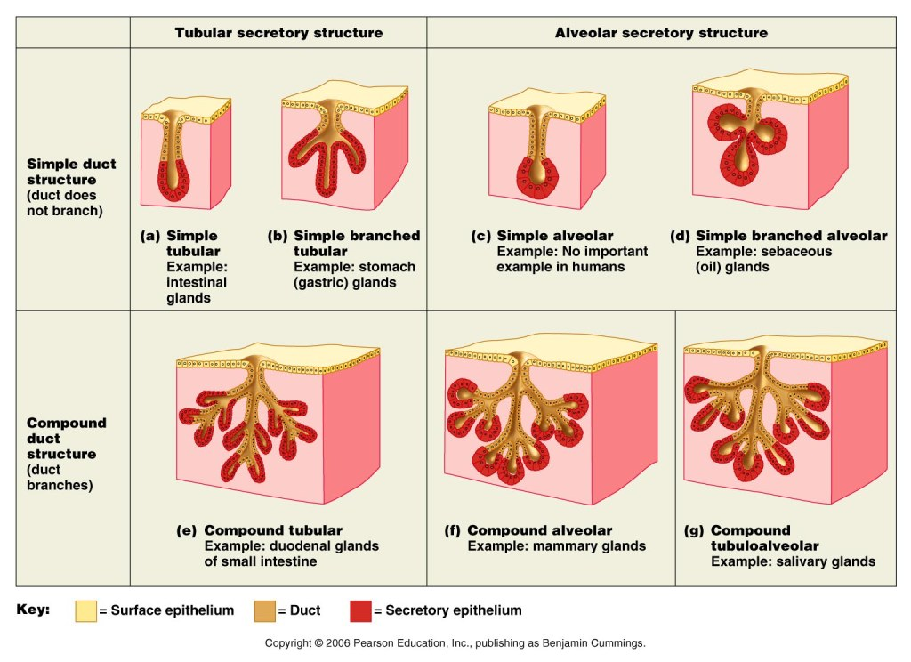

Slide 9
V. CONNECTIVE TISSUE
most abundant & widely distributed tissue in various degrees
functions
binding & support
protection
insulation
transportation

Slide 10
A. Types of CT

Slide 11
1. Mesenchyme
function: origin for all CT
location: embryo

Slide 12
2. Areolar
function: wraps & cushions organs
location: widely distributed under epithelia tissue of body

Slide 14
3. Adipose
function: provide fuel, insulates, supports & protects organs
location: under skin, around kidneys & eyeballs

Slide 16
4. Reticular
function: support
location: lymph nodes, bone & spleen

Slide 17
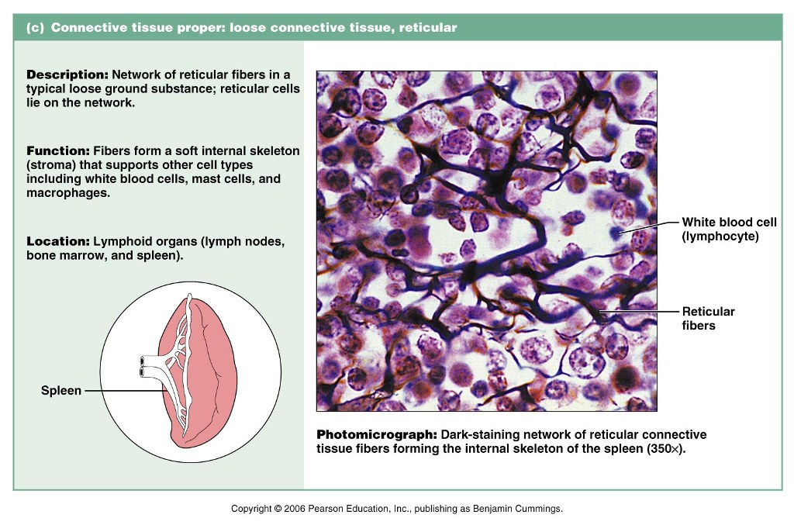

Slide 18
5. Dense Regular
function: attaches muscle to bone or to muscle, withstands tension in one direction
location: tendons & ligaments

Slide 20
6. Dense Irregular
function: structural strength, withstands tension in several directions
location: dermis of skin, digestive tract, fibrous capsule of organs & joints

Slide 22
7. Hyaline Cartilage
function: support & reinforce cushions
location: ends of long bones, costal cartilage of ribs, nose, trachea & larynx

Slide 24
8. Elastic Cartilage
function: maintains shape but allows flexibility
location: ear, epiglottis

Slide 26
9. Fibrocartilage
function: strength& absorption of compressive shock
location: intervertebral discs, pubic symphysis, discs of knee joint

Slide 28
10. Bone
function: support
location: bones

Slide 30
11. Blood
function: transportation
location: blood vessels

Slide 32
VI. EPITHELIAL MEMBRANES
membranes that incorporate both types of tissues already discussed:
epithelial tissue & connective tissue

Slide 33
types:
1. Cutaneous Membranes: skin
2. Mucous Membranes: line body cavities
3. Serous Membranes: sac-like structures
pericardium & pleura

Slide 34
Cutaneous & Mucous Membranes
Figure 4.12a

Slide 35
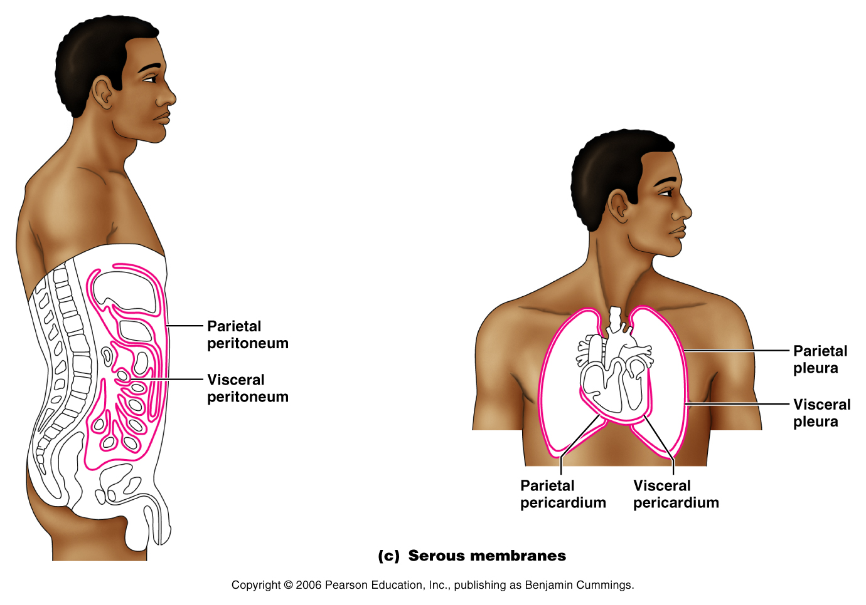
Serous Membranes
Figure 4.12c

Slide 36
DESCRIPTION OF SEROUS MEMBRANES
Visceral – the part of the membrane lying closest to the organs it surrounds (inner layer)
Parietal – the part of the membrane lying furthest from the organs it surrounds (outer layer)
“Balloon” Example

Slide 37
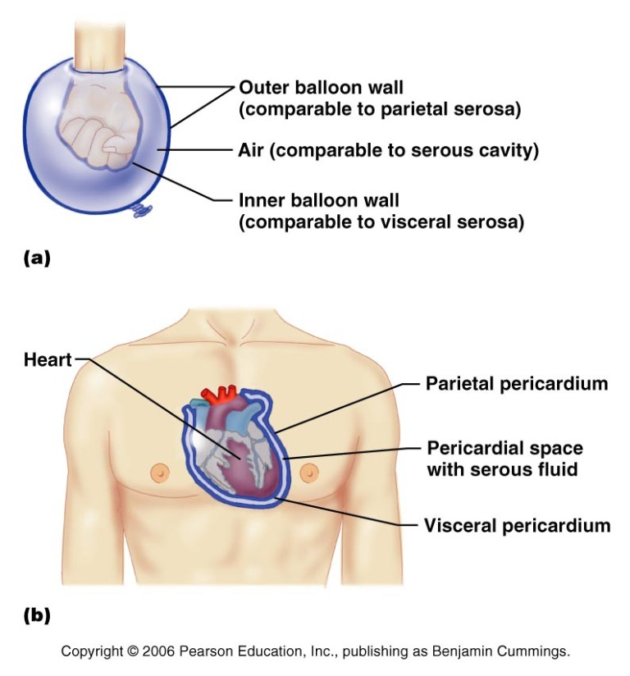

Slide 38
VII. MUSCLE TISSUE
Function: to provide movement through contractility

Slide 39
Types:
Skeletal: striated, attached to bones
Cardiac: striated, only in heart
Smooth: no striations, walls of internal organs, digestive tract, urinary, uterus, blood vessels

Slide 40
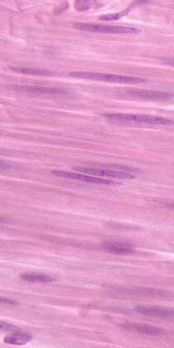
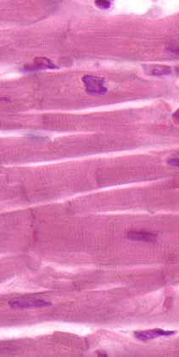
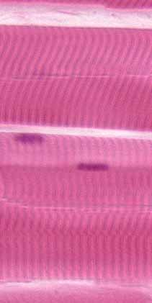
Smooth Muscle
Cardiac Muscle
Skeletal muscle

Slide 41
VIII. NERVOUS TISSUE
Function: regulates & controls body functions
2 cell types:
neurons: conduct nerve impulses
supporting cells: protect neurons & are nonconducting

Slide 42
