Slide 1
Cells & Tissues
Chapter 3

Slide 2
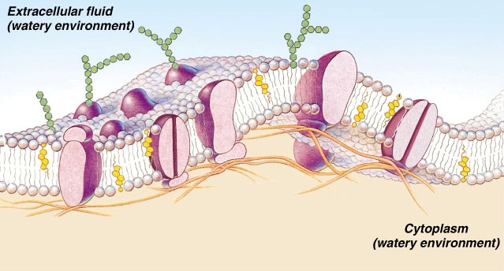
I. The Plasma Membrane Structure

Slide 3
A. Fluid Mosaic Model
Double bilayer of lipids with imbedded, dispersed proteins
Bilayer consists of phospholipids, cholesterol, and glycolipids
Glycolipids are lipids with bound carbohydrate
Phospholipids have hydrophobic tails and hydrophilic heads

Slide 4
cholesterol: stabilizes lipid membrane
integral proteins:
some face outside of membrane, usually receptors for hormones or other chemical messengers
transmembrane proteins span entire width of membrane & protrude on both sides
transport functions
peripheral proteins: not embedded in lipid
enzymes

Slide 5
glycocalyx: cell coat
stickiness helps bind adjacent cells together
every cell has different pattern of sugars & proteins, biological markers for cell recognition
figure 3.2 p.58

Slide 6
B. Specializations of Plasma Membrane
microvilli: fingerlike extensions of plasma membrane
increase cell membrane surface area
absorption: intestine & kidney

Slide 7
p. 59 figure 3.3
Tight junctions: binds cell together into leak proof sheets
Intestines prevent digestive enzymes from seeping into bloodstream
Desmosomes: anchoring junctions for cells subjected to mechanical stress
Gap junctions: allow communication between cells

Slide 8
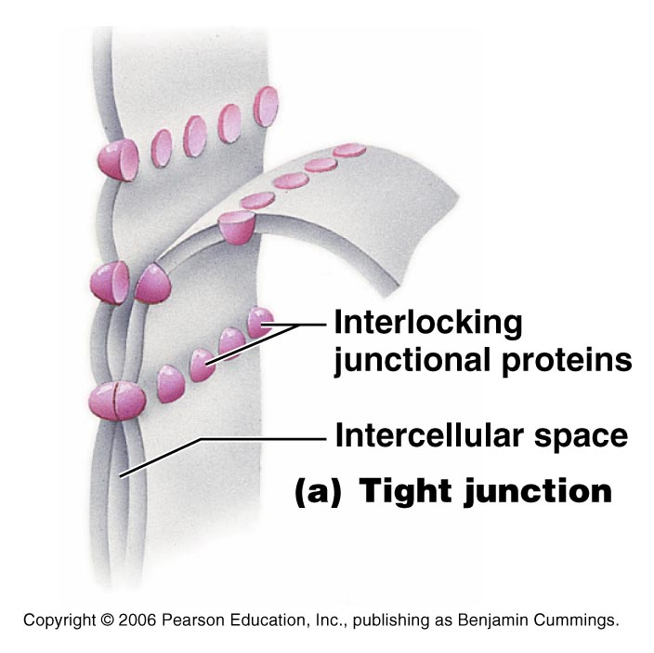
Tight Junctions

Slide 9
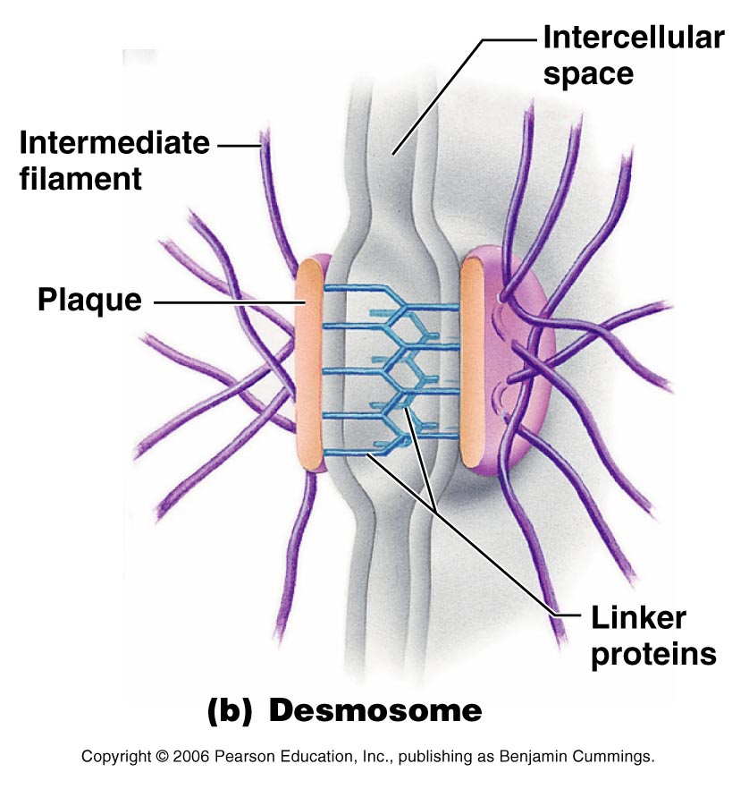
Desmosomes
http://www.answers.com/topic/desmosome

Slide 10
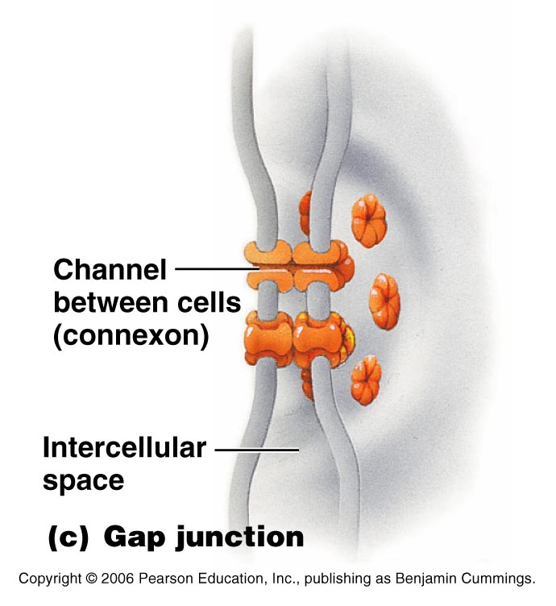
Gap Junctions

Slide 11
II. Cell Physiology

Slide 12
A. Membrane Transport
cells are continuously bathed in extracellular fluid called interstitial fluid largely composed of water
contains nutrients, hormones, salts, & waste products

Slide 13
to stay healthy each cell must extract exact amounts of substances needed from this fluid & reject the rest
membrane is selectively permeable: it allows some to pass while excluding others

Slide 14
B. Passive Processes
substances penetrate membrane without any energy input from cell
1. simple diffusion
2. osmosis
3. facilitated diffusion
4. filtration

Slide 15
C. Active Transport Processes
Primary active transport – hydrolysis of ATP phosphorylates the transport protein causing conformational change
Secondary active transport – use of an exchange pump (such as the Na+-K+ pump) indirectly to drive the transport of other solutes

Slide 16
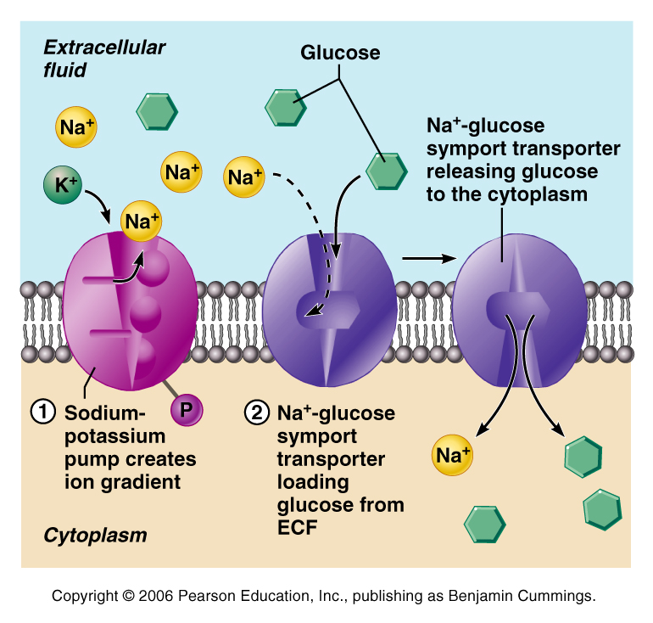

Slide 17
substances are too large or have to move against the concentration gradient
1. Solute Pumping
2. Bulk Transport
endocytosis: phagocytosis or pinocytosis
exocytosis

Slide 18
Passive Membrane Transport – Review
Process | Energy Source | Example
Simple diffusion | Kinetic energy | Movement of O₂ through membrane
Facilitated diffusion | Kinetic energy | Movement of glucose into cells
Osmosis | Kinetic energy | Movement of H₂O in & out of cells
Filtration | Hydrostatic pressure | Formation of kidney filtrate

Slide 19
Active Membrane Transport – Review
Process | Energy Source | Example
Active transport of solutes | ATP | Movement of ions across membranes
Exocytosis | ATP | Neurotransmitter secretion
Endocytosis | ATP | White blood cell phagocytosis
Fluid-phase endocytosis | ATP | Absorption by intestinal cells
Receptor-mediated endocytosis | ATP | Hormone and cholesterol uptake
Endocytosis via caveoli | ATP | Cholesterol regulation
Endocytosis via coatomer vesicles | ATP | Intracellular trafficking of molecules

Slide 20
D. Membrane Potential
Voltage across a membrane
Resting membrane potential (RMP) – the point where K⁺ potential is balanced by the membrane potential
Ranges from –20 to –200 mV (depends on cell)
Results from differential permeability of the plasma membrane to Na⁺ and K⁺
Steady state – potential maintained by active transport of ions

Slide 21
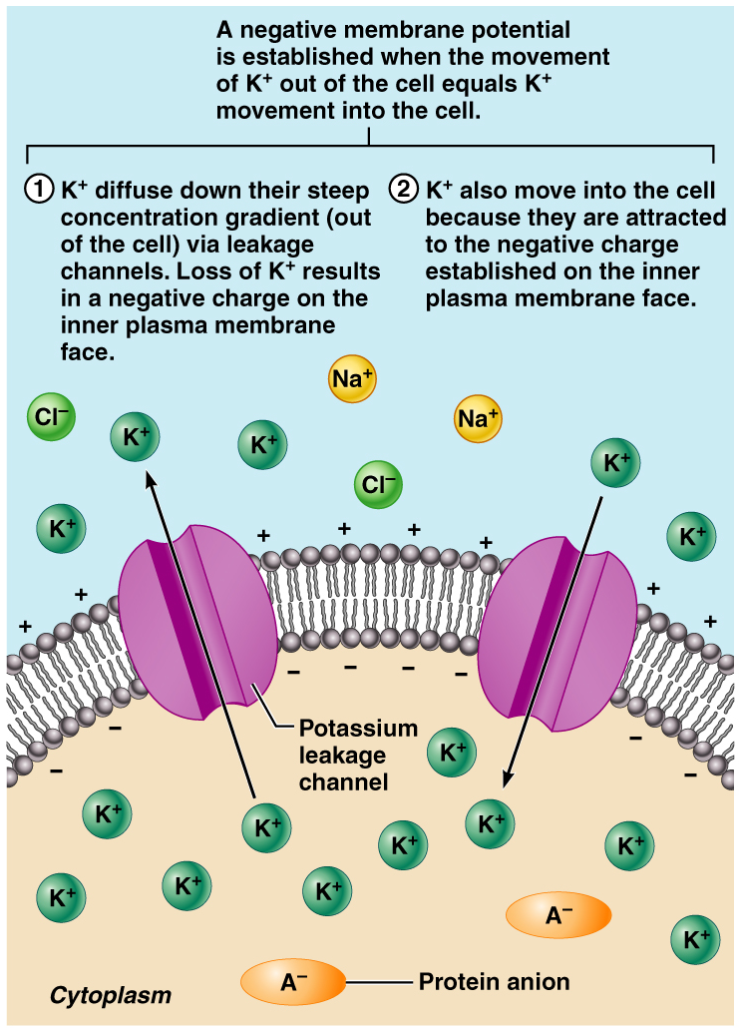
Generation and Maintenance of Membrane Potential

Slide 22
E. Cell Signaling
Contact signaling – important in normal development and immunity
Electrical signaling – voltage-regulated “ion gates” in nerve and muscle tissue
Chemical signaling – neurotransmitters bind to chemically gated channel-linked receptors in nerve and muscle tissue
G protein-linked receptors – ligands bind to a receptor which activates a G protein, causing the release of a second messenger, such as cyclic AMP or Tyrosine Kinase.

Slide 23
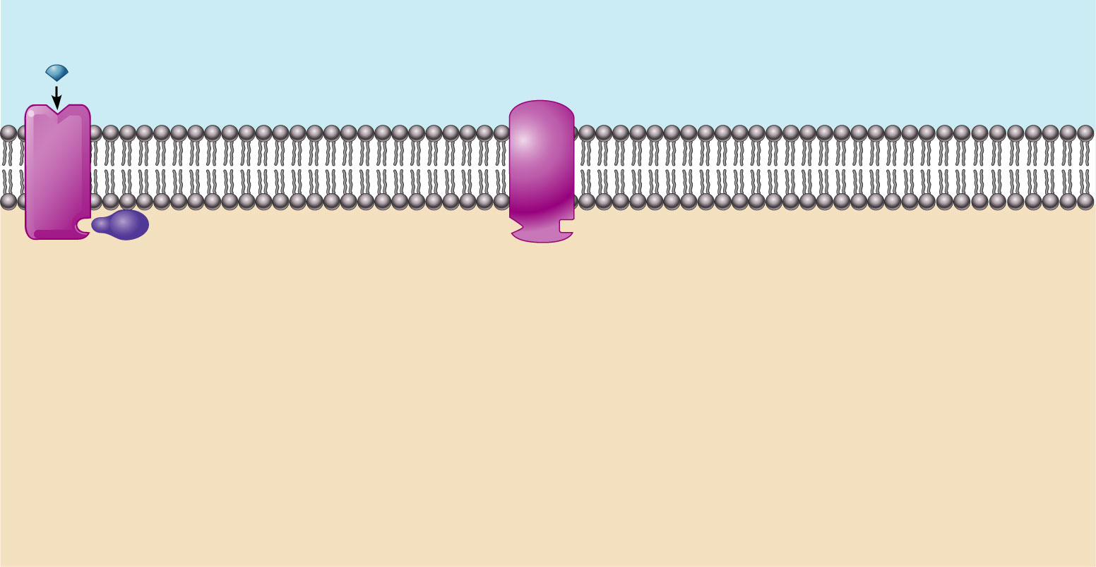
Amino Acid-Based Hormone Action: cAMP Second Messenger
Extracellular fluid
Hormone A
Adenylate cyclase
Receptor
G_{s}
Catecholamines
ACTH
FSH
LH
Glucagon
PTH
TSH
Calcitonin
Cytoplasm
Figure 16.2

Slide 24
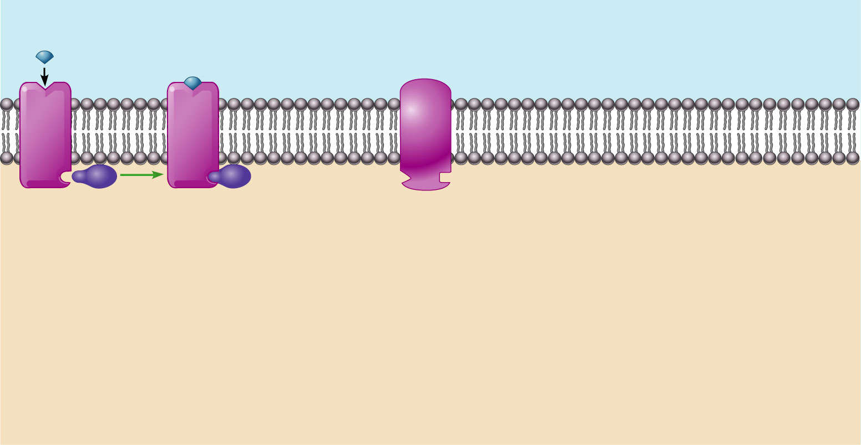
Amino Acid-Based Hormone Action: cAMP Second Messenger
Extracellular fluid
Hormone A
Adenylate cyclase
1
Receptor
G_{s}
Catecholamines
ACTH
FSH
LH
Glucagon
PTH
TSH
Calcitonin
Cytoplasm
Figure 16.2

Slide 25
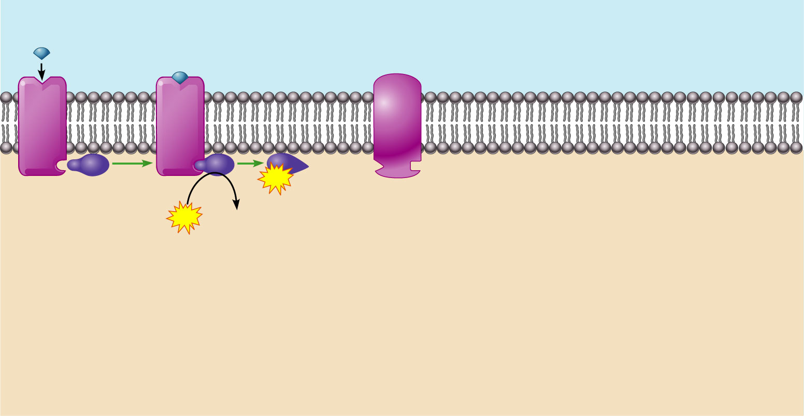
Amino Acid-Based Hormone Action: cAMP Second Messenger
Extracellular fluid
Hormone A
Adenylate cyclase
1
2
GTP
Receptor
G_{s}
GTP
GDP
Catecholamines
ACTH
FSH
LH
Glucagon
PTH
TSH
Calcitonin
Cytoplasm
Figure 16.2

Slide 26
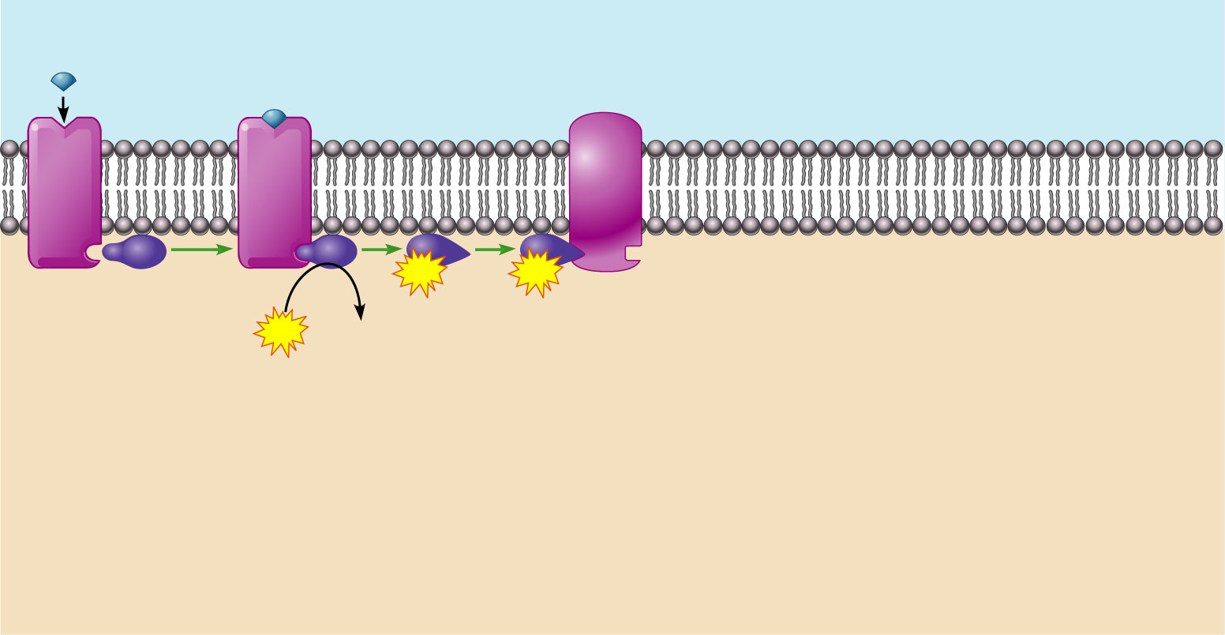
Amino Acid-Based Hormone Action: cAMP Second Messenger
Extracellular fluid
Hormone A
Adenylate cyclase
1
2
GTP
3
GTP
Receptor
G_{s}
GTP
GDP
Catecholamines
ACTH
FSH
LH
Glucagon
PTH
TSH
Calcitonin
Cytoplasm
Figure 16.2

Slide 27
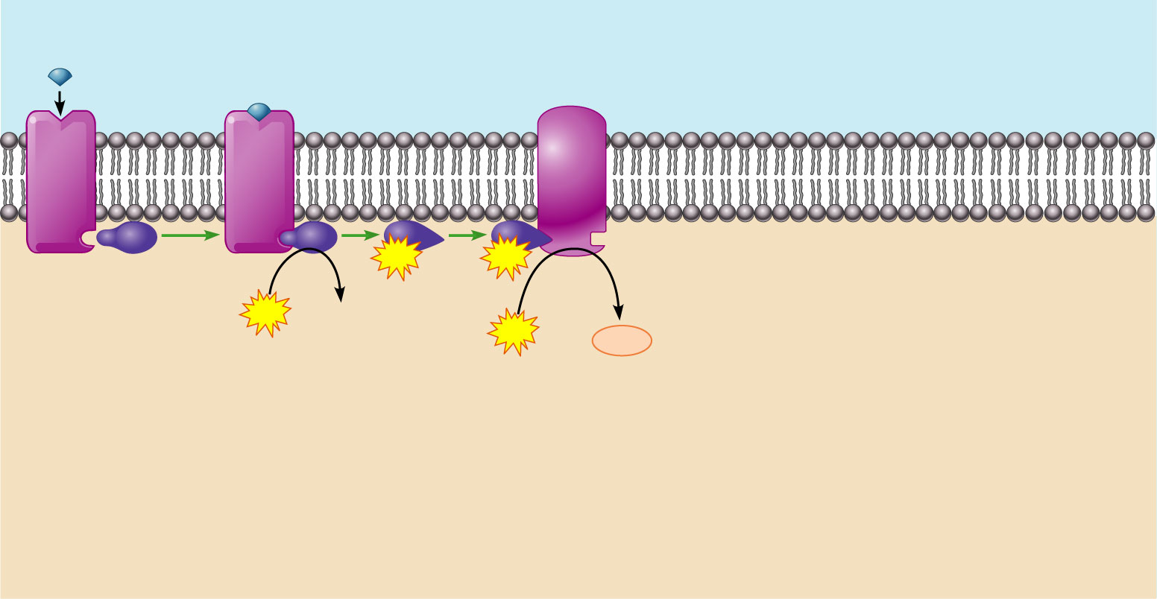
Amino Acid-Based Hormone Action: cAMP Second Messenger
Extracellular fluid
Hormone A
Adenylate cyclase
1
2
GTP
3
GTP
Receptor
G_{s}
4
GTP
GDP
Catecholamines
ACTH
FSH
LH
Glucagon
PTH
TSH
Calcitonin
ATP
cAMP
Cytoplasm
Figure 16.2

Slide 28
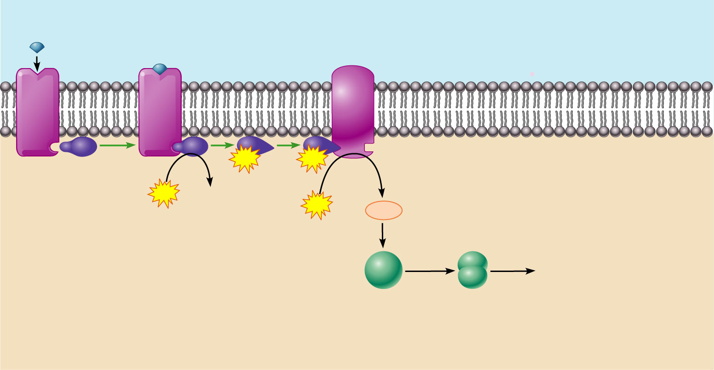
Amino Acid-Based Hormone Action: cAMP Second Messenger
Extracellular fluid
Hormone A
Adenylate cyclase
1
2
GTP
3
GTP
Receptor
G_{s}
4
GTP
GDP
Catecholamines
ACTH
FSH
LH
Glucagon
PTH
TSH
Calcitonin
ATP
cAMP
5
Triggers responses of target
cell (activates enzymes,
stimulates cellular
secretion, opens ion
channels, etc.)
Inactive
protein
kinase A
Active
protein
kinase A
Cytoplasm
Figure 16.2

Slide 29
III. Body Tissues
Histology: study of tissues
groups of similar cells associated to perform a related function

Slide 30
TYPE
1. Epithelial
2. Connective
3. Muscle
4. Nervous
PURPOSE
Covering
Support
Movement
Control

Slide 31
IV. EPITHELIAL TISSUES
sheet of cells that covers a body surface or lines a body cavity
cells fit so close to make continuous sheets
contains nerve but no blood vessels
quick regeneration

Slide 32
A. Classification
1. Simple: single layer of cells, used for absorption or filtration
Squamous: lymph system & lines organs
Cuboidal: exocrine glands and kidneys
Columnar: digestive system

Slide 34
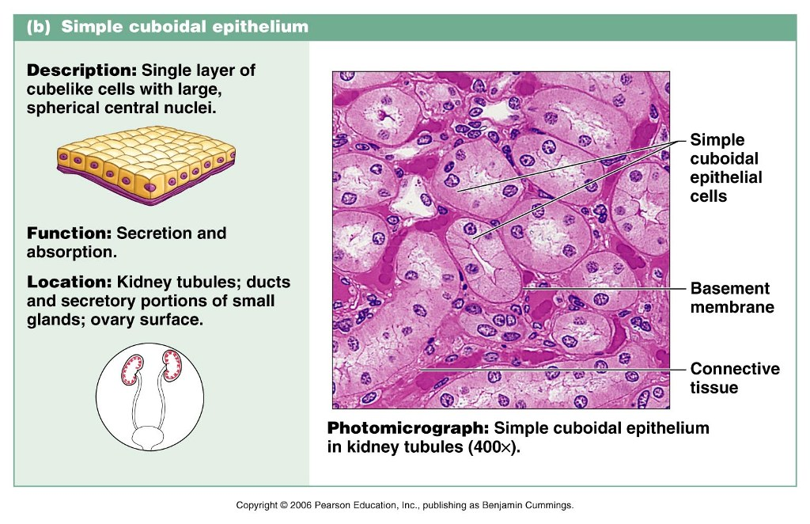

Slide 35
